Slide 1
Introduction to the Unified Registration System (URS)
Unified Registration System (URS)
URS New Application Release for First-Time Applicants, December 2015 v1.0
Notes:
Introduction to the Unified Registration System (URS)

Slide 2
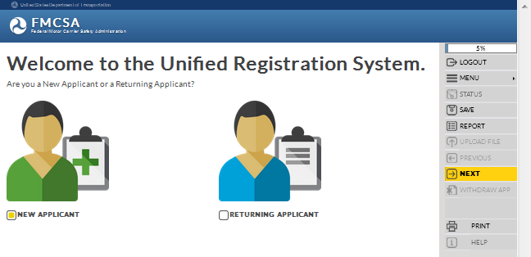
Training Objectives
Provide an introduction to the Unified Registration System (URS)
Notes:
Training Objectives.
The training objectives for this module is to provide an introduction of the Unified Registration System (URS).

Slide 3
What is the Unified Registration System (URS)?
A new online registration system that will streamline and simplify the Federal Motor Carrier Safety Administration’s (FMCSA) registration process:
Combining multiple registration processes
Consolidating information technology systems
Consolidating forms into a single registration process
A clearinghouse and depository of information on all entities regulated by the Agency
Notes:
What is the Unified Registration System (URS)?
The Unified Registration System (URS) is a new electronic online registration system that will streamline and simplify the Federal Motor Carrier Safety Administration’s (FMCSA) registration process. The URS will:
Combine multiple registration processes
Consolidate information technology systems
Consolidate forms into a single registration process
The URS will serve as a clearinghouse and depository of information on all entities regulated by the Agency, including motor carriers, intermodal equipment providers (IEPs), hazardous materials safety permit (HMSP) applicants/holders, brokers, freight forwarders, and cargo tank (CT) manufacturing and repair facilities.

Slide 4
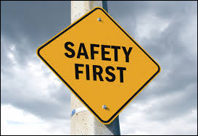
Why did FMCSA undertake the URS rulemaking?
To simplify and reduce the amount of time entities spend filing out paperwork as a part of the registration process
To maintain more accurate information on the entities subject to FMCSA’s jurisdiction
To support the Department of Transportation (DOT) goals concerning safety ensuring FMCSA can increase the accessibility and track more efficiently the data for entities regulated by the Agency
Notes:
Why did FMCSA undertake the URS rulemaking?
FMCSA undertook this rulemaking to simplify and reduce the amount of time regulated entities must spend filling out paperwork as part of the registration process.
To enable the Agency to maintain more accurate information on the entities subject to FMCSA’s jurisdiction.
To support the Department of Transportation (DOT) strategic goals concerning safety by ensuring FMCSA can increase the accessibility and more efficiently track data related to the regulated entities that are required to register with FMCSA.

Slide 5
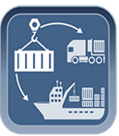
Who is required to comply with this rule?
All entities regulated by the Agency:
Motor Carriers
Intermodal Equipment Providers (IEPs)
Hazardous Materials Safety Permit Applicants/Holders (HMSPs)
Brokers
Freight Forwarders
Cargo Tank Facilities
Notes:
Who is required to comply with this rule?
All entities regulated by the Agency:
Motor Carriers
Intermodal Equipment Providers (IEPs)
Hazardous Materials Carriers
Hazardous Materials Safety Permit Holders (HMSPs)
Brokers
Freight Forwarders
Cargo Tank Facilities

Slide 6
URS Features and Benefits
Simplified processes and combined forms, using a single online, interactive registration process
Reduced paperwork and errors
Reduced application review and approval times, increasing efficiency
Improved accountability
Notes:
URS Features and Benefits.
The URS will streamline manual processes and combine several disparate forms, and information technology systems, into a single electronic online registration process saving time and money for the industry and FMCSA.
It will enable entities under FMCSA jurisdiction to submit required registration information to the Agency via the new online process.
The URS features and benefits include the following:
Simplified registration processes, combining forms, using a single online, interactive registration process
Reduced paper work for the industry and FMCSA
Reduced errors and collecting and maintaining more accurate information on regulated entities
Reduced application reviews and approval times, increasing efficiency
Improved accountability
This rule will also improve FMCSA’s ability to locate small and medium-sized private and exempt for-hire motor carriers. Investigators will be able to serve documents on hard-to-find motor carriers using designated process agents.
URS will make the FMCSA's Compliance, Safety, Accountability (CSA) program more efficient by linking the online registration system to the carrier safety initiative.

Slide 7
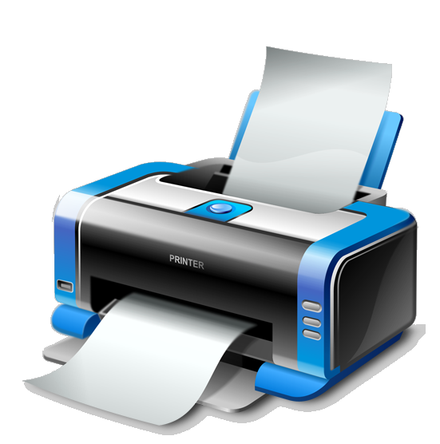
URS Features and Benefits (Cont.)
Raising the bar for safety
Ability to print the application for registration, upload documents and submit payment for fees
Ability to save an incomplete application for 30 calendar days
Notes:
Additional URS Features and Benefits include:
URS directly supports the FMCSA’s strategic plan, raising the bar for safety and to enter the motor carrier industry and enabling FMCSA to maintain more accurate information on regulated entities
Provides the capability to print the application, upload documents and submit payment for fees
Provides the capability to save an incomplete application for 30 calendar days before it’s discarded by the system

Slide 8
Key URS Changes
Regulated Entities will be required to submit requests for new registration with FMCSA electronically utilizing the new URS Online Application Process
New requests for registration must be submitted electronically
Paper form submissions will not be accepted
For the latest information on the phased implementation of URS, please visit www.fmcsa.dot.gov/urs
Notes:
Key URS Changes.
When the URS is implemented, regulated entities will be required to electronically request New Registration with FMCSA using the URS Online Application Process.
New requests for registration must be submitted electronically. Paper forms will no longer be accepted.
For the latest information on the phased implementation of URS, please visit www.fmcsa.dot.gov/urs

Slide 9
End of the Training Module
End of the Training Module
Please Close the Browser Window
Notes:
End of the Training Module. Please close the browser window.

