Slide 1
Intermodal Equipment Provider (IEP) U.S. and Canada: Submit an Application for New Registration
Unified Registration System (URS)
URS New Application Release for First-Time Applicants, December 2015, v1.0
Notes:
Unified Registration System (URS).
Intermodal Equipment Provider (IEP) United States and Canada: Submit an Application for New Registration

Slide 2
Training Objectives
Prerequisite: Completion of the training module titled ‘Introduction to Submit an Application for New Registration’
Provide Intermodal Equipment Providers (IEP) an overview for submitting an application for New Registration using the URS Online Application Process
The functionality in this module includes the following:
Completing the Application for New Registration
Notes:
Training Objectives.
The prerequisite for this training module is the completion of the training module titled ‘Introduction to Submit an Application for New Registration’ .
A training objective is to provide Intermodal Equipment Provider an overview for submitting an application for New Registration using the URS Online Application Process.
The functionality in this module includes the following:
Completing the Application for New Registration

Slide 3
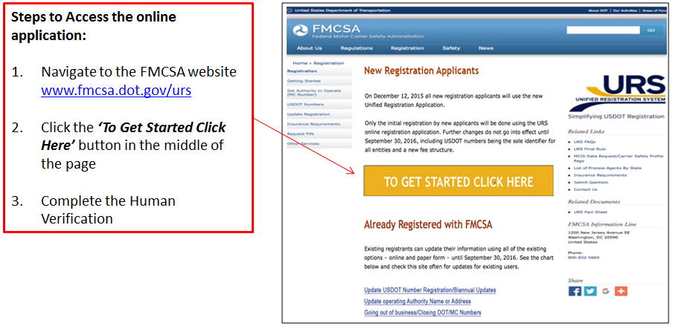
Accessing the URS Online Application Process
To apply for New Registration the URS Online Application Process can be accessed from the FMCSA Website, www.fmcsa.dot.gov/urs
Notes:
Accessing the URS Online Application Process.
To apply for New Registration the URS Online Application Process can be accessed from the FMCSA Website, www.fmcsa.dot.gov/urs.
These are the steps to access the online application:
Navigate to the FMCSA Website
Click the “To Get Started Click Here” button in the middle of the page
Completed the Human Verification

Slide 4
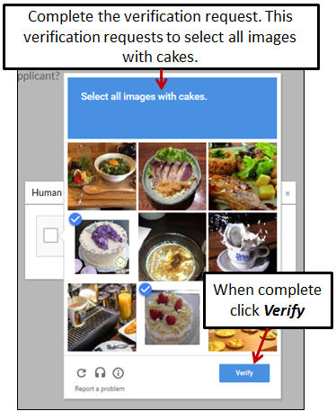
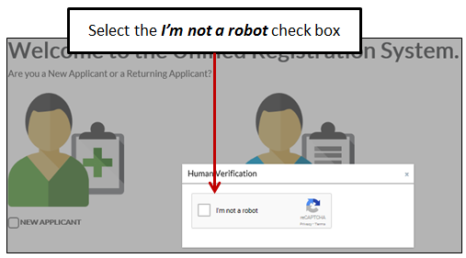
Accessing the URS Online Application Process (Cont.)
Before accessing the application the Applicant will need to provide Human Verification
Select the check box I’m not a robot
Complete the verification request
Notes:
Before accessing the application the Applicant will need to provide Human Verification.
Select the check box I’m not a robot
Complete the verification request
When complete, click Verify

Slide 5
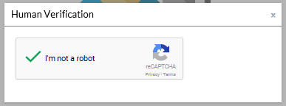
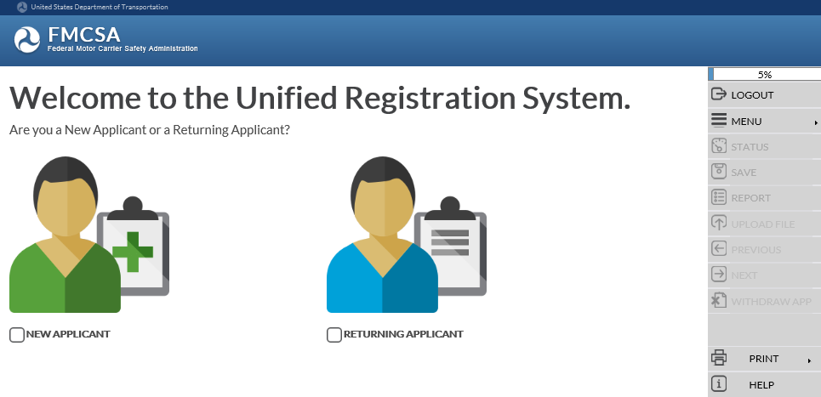
Accessing the URS Online Application Process (Cont.)
The system will display a green check mark confirming the human verification
The system will display the URS Welcome Page
Notes:
The system will display a green check mark confirming the human verification.
The system will display the URS Welcome page.

Slide 6
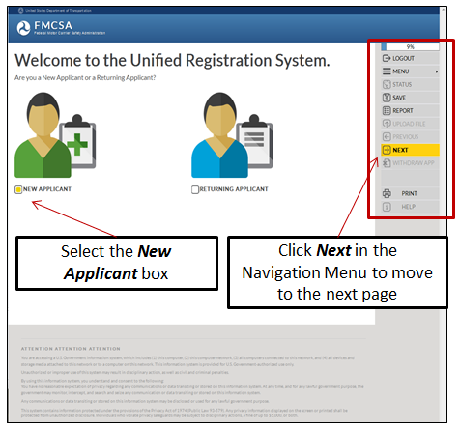
Welcome Page
Applicants applying for New Registration select the New Applicant box under the green avatar on the left side of the page
When all the information on a page has been provided, the Next button in the Navigation Menu on the right side of the page will display yellow
Click Next in the Navigation Menu to move to the next page
Notes:
Welcome Page.
The Welcome page provides the Applicant the option to choose New Applicant or Returning Applicant.
Applicants applying for New Registration select the New Applicant box under the green avatar on the left side of the page.
When all the information on a page has been provided, the Next option in the Navigation Menu on the right of the page will display yellow.
The Navigation Menu on the right side of the page will display throughout the URS Online Application Process.
Click Next in the Navigation Menu to move to the next page.

Slide 7
Detailed Information for the URS Online Application Process
Reference the training module ‘Introduction to Submit an Application for New Registration’ for detailed information on the following topics:
Navigating the URS Online Application Process
Required Information
Informational Notices
Application Contact Information
Business Description Information
Process Agent Designation
Financial Responsibility
Affiliation with Others
Certification Statement
Compliance Certifications
Applicant’s Oath
Submitting Payment
Uploading Documents
Returning to Complete an Incomplete Application
Notes:
Detailed Information for the URS Online Application Process.
Reference the training module ‘Introduction to Submit an Application for New Registration’ for detailed information on the following topics and application sections:
Navigating the URS Online Application Process
Required Information
Informational Notices
Application Contact Information
Business Description Information
Process Agent Designation
Financial Responsibility
Affiliation with Others
Certification Statement
Compliance Certifications
Applicant’s Oath
Submitting Payment
Uploading Documents
Returning to Complete an Incomplete Application

Slide 8
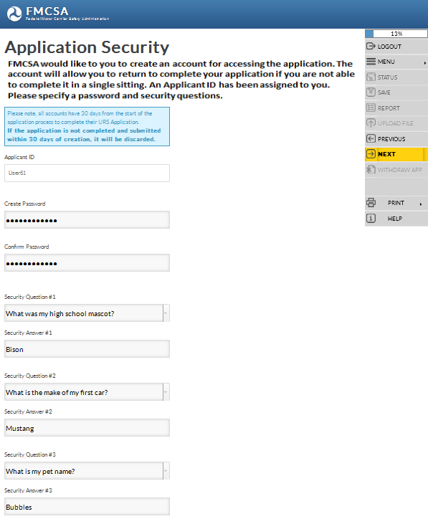
Application Security
FMCSA would like to you to create an account for accessing the application:
Applicant ID is system generated and assigned to the Applicant
Enter a Password and Re-enter/Confirm Password, following the Password Requirements
Select three Security Questions and enter three Security Answers
Create a Password
Use the drop down arrow and select three Security Questions
Enter the Security Answers
Notes:
Application Security.
FMCSA would like to you to create an account for accessing the application. The account will allow you to return to complete your application if you are not able to complete it in a single sitting.
The Applicant ID is system generated and assigned to the Applicant and associated to the application being completed.
The Applicant will need to create a password, select three security questions and provide the answers.
A saved application must be completed within 30 calendar days of the saved date.
Enter a Password and Re-enter or Confirm the Password following the Password Requirements.
Use the Security Question drop down arrow to view the different questions. Select three Security Questions and provide the Security Answers in the blank fields.
The Application Security Page can be printed to retain the information for future use.
For more detailed information about the Application Security section of the application, reference the training module: “Introduction to Submit an Application for New Registration”.
Click Next in the Navigation Menu to move to the next page.

Slide 9
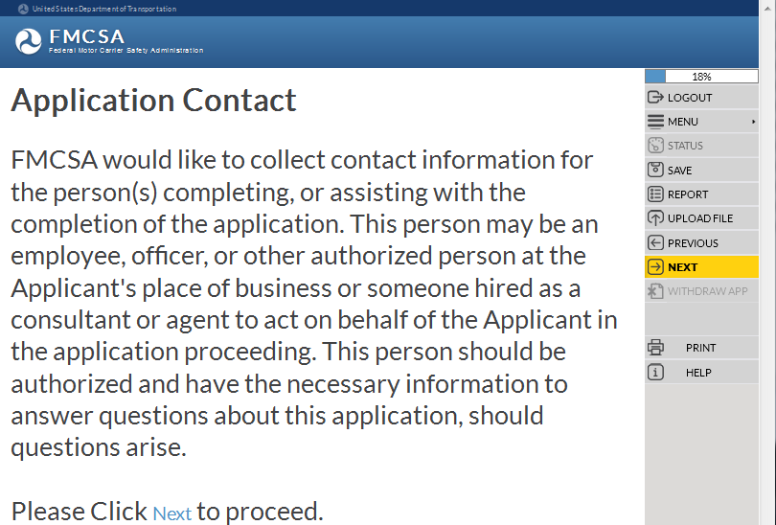
Application Contact
For detailed information on this application section, reference the training module: “Introduction to Submit an Application for New Registration”
FMCSA would like to collect contact information from the person(s) who is preparing or assisting with the completion of the application:
Application Contact Type
First, Middle, Last Name and Suffix
Title
Address
Email Address
Telephone, Fax and Cell Phone Numbers
Preferred Contact Method
Notes:
Application Contact.
FMCSA would like to collect contact information for the person(s) completing, or assisting with the completion of the application. This person may be an employee, officer, or other authorized person at the Applicant's place of business or someone hired as a consultant or agent to act on behalf of the Applicant in the application proceeding. This person should be authorized and have the necessary information to answer questions about this application, should questions arise.
The information includes the following:
Application Contact Type
First Name
Middle Name
Last Name
Suffix, values include: Jr., Sr., 2nd , 3rd , II, III, IV, V, VI
Title
Address
Email Address
Telephone, Fax and Cell Phone Numbers
Preferred Contact Method
For more detailed information about the Application Contact section of the application, reference the training module: “Introduction to Submit an Application for New Registration”.
Enter the information and click Next in the Navigation Menu to move to the next page.

Slide 10
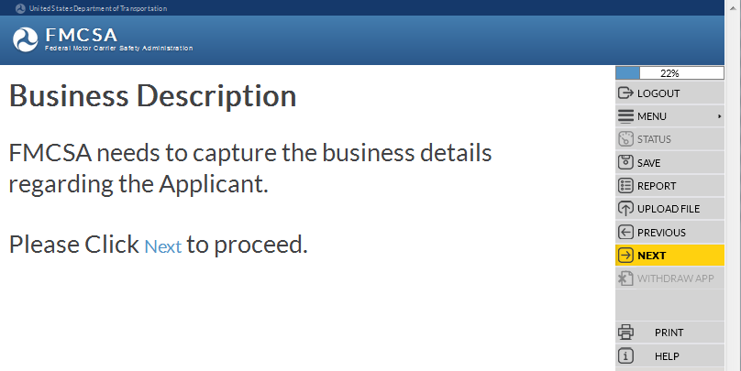
Business Description
FMCSA needs to capture the business details regarding the Applicant:
Dunn & Bradstreet Number
Legal and Doing Business As Name
Principal Place of Business Addresses
Telephone, Fax, Cell Numbers
EIN or SSN
If applicable, Canadian NCS Number
If applicable, Mexico RFC Number
Unit of Government
For detailed information on this application section, reference the training module: “Introduction to Submit an Application for New Registration”
Form of Business
Ownership and Control
Company Contact Names, Titles and Addresses
Notes:
Business Description.
FMCSA needs to capture the business details regarding the Applicant applying for new registration.
The information includes the following:
Dunn & Bradstreet Number
Legal and Doing Business As Name
Principal Place of Business Addresses
Telephone, Fax, Cell Numbers
EIN or SSN
If applicable, Canadian NCS Number
If applicable, Mexico RFC Number
Unit of Government
Form of Business
Ownership and Control
Company Contact Names, Titles and Addresses
For more detailed information about the Business Description section of the application, reference the training module: “Introduction to Submit an Application for New Registration”.
Enter the information and click Next in the Navigation Menu to move to the next page.

Slide 11
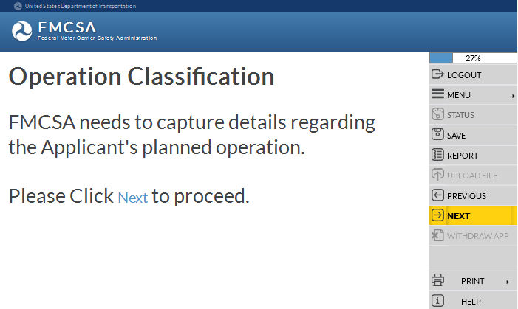
Operation Classification
Some of the questions in the following section may or may not display in the URS Online Application Process.
The questions display based on the answers selected or entered by the Applicant.
FMCSA needs to capture details regarding the Applicant’s planned operation:
Intermodal Equipment Provider
Transporting Property
Broker Services (Property, HHG)
Type of Cargo or Property Transporting
Transporting passengers
Freight Forwarder Services
Cargo Tank Facility
Driveaway or Towaway
Classification of Cargo
Notes:
Operation Classification.
Some of the questions in the following section may or may not display in the URS Online Application Process.
The questions display based on the answers selected or entered by the Applicant.
FMCSA needs to capture details regarding the Applicant’s planned operation.
This includes the following information:
Intermodal Equipment Provider
Transporting Property
Broker Services
Type of Cargo or Property Transporting
Transporting across state lines with/without HM
Transporting passengers
Receiving a grant from the FTA
Freight Forwarder Services
Cargo Tank Facility
Driveaway or Towaway
Classification of Cargo
Click Next in the Navigation Menu to move to the next page.

Slide 12
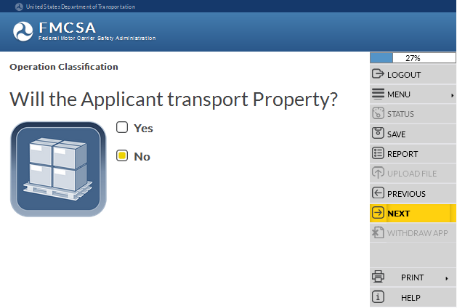
Operation Classification (Cont.)
Will the Applicant operate as an Intermodal Equipment Provider (IEP)?
Will the Applicant transport property?
Select Yes
Select No
Notes:
Will the Applicant operate as an Intermodal Equipment Provider (IEP)?
If the Applicant will operate as an IEP select the Yes box.
Click Next in the Navigation Menu to move to the next page.
Will the Applicant transport Property?
If the Applicant will NOT transport property select the No box.
Click Next in the Navigation Menu to move to the next page.

Slide 13
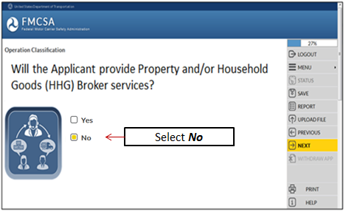
Operation Classification (Cont.)
Will the Applicant transport any Passengers?
Will the Applicant provide Property and/or Household Goods (HHG) Broker services?
Select No
Notes:
Will the Applicant transport any Passengers?
If the Applicant will NOT transport any Passengers, select the No box.
Click Next in the Navigation Menu to move to the next page.
Will the Applicant provide Broker services?
If the Applicant will NOT provide Broker services, select the No box.
Click Next in the Navigation Menu to move to the next page.

Slide 14
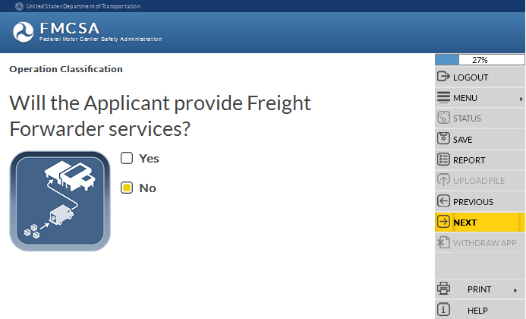
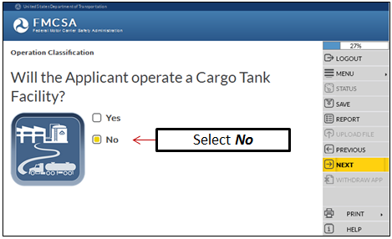
Operation Classification (Cont.)
Will the Applicant provide Freight Forwarder services?
Will the Applicant operate a Cargo Tank Facility?
Select No
Notes:
Will the Applicant provide Freight Forwarder services?
If the Applicant will NOT provide Freight Forwarder services, select the No box.
Click Next in the Navigation Menu to move to the next page.
Will the Applicant operate a Cargo Tank Facility?
If the Applicant will NOT operate a Cargo Tank Facility, select the No box.
Click Next in the Navigation Menu to move to the next page.

Slide 15
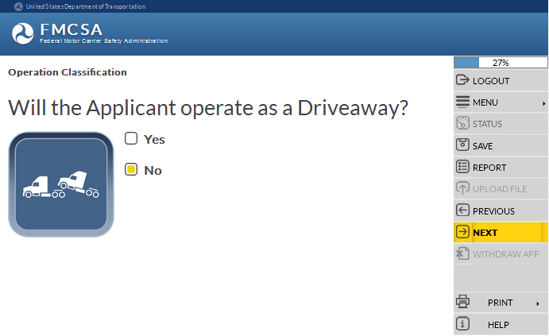
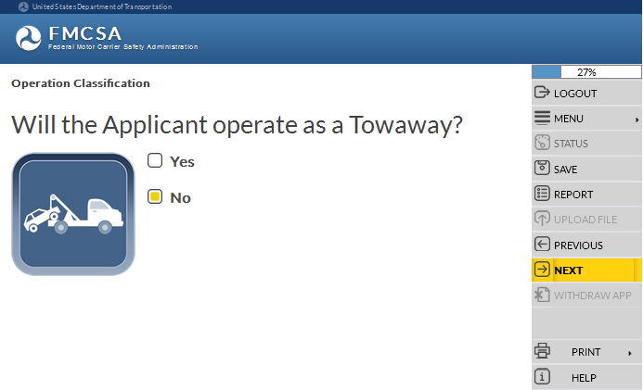
Operation Classification (Cont.)
Will the Applicant operate as a Driveaway?
Will the Applicant operate as a Towaway?
Select No
Select No
Notes:
Will the Applicant operate as a Driveaway?
If the Applicant will NOT operate as a Driveaway, select the No box.
Click Next in the Navigation Menu to move to the next page.
Will the Applicant operate as a Towaway?
If the Applicant will NOT operate as a Towaway, select the No box.
Click Next in the Navigation Menu to move to the next page.

Slide 16
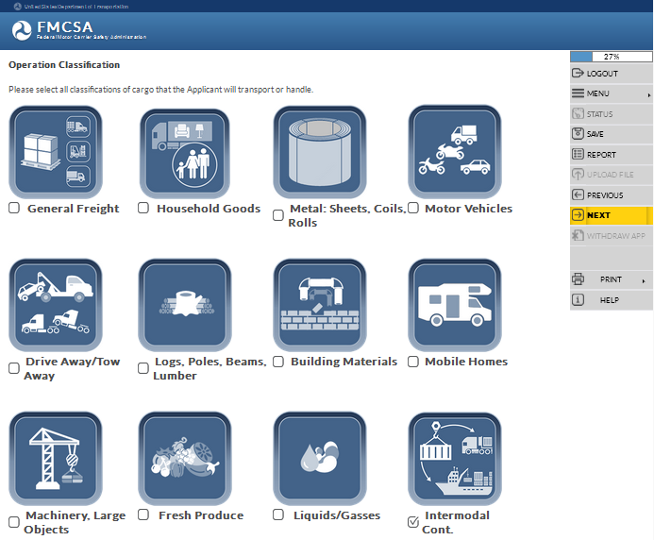
Operation Classification (Cont.)
Please select all classifications of cargo that the Applicant will transport or handle.
Select Intermodal Cont.
Notes:
Please select all classifications of cargo that the Applicant will transport or handle.
Select Intermodal Cont.
Click Next in the Navigation Menu to move to the next page.

Slide 17
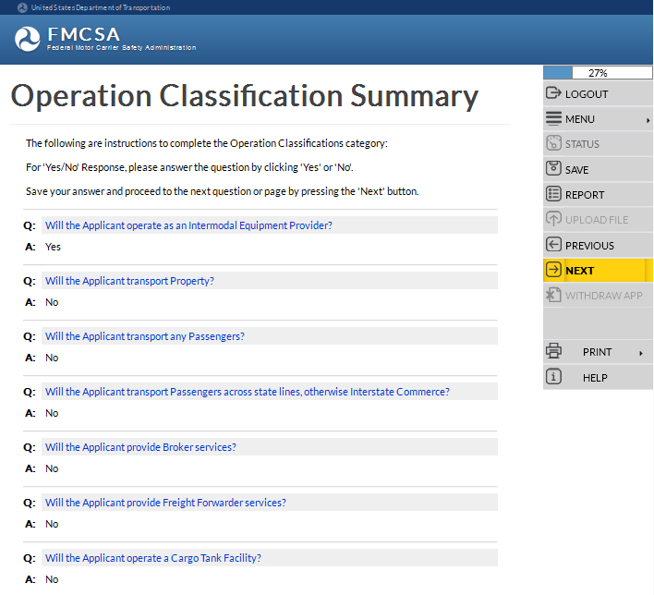
Operation Classification (Cont.)
Review the Operation Classification Summary to ensure the answers provided are correct
To change an answer, click the question text
To edit an answer click the question text
Notes:
Review the Operation Classification Summary of questions and answers to ensure the information provided is correct.
To edit the answer to a question, click the question text to return to the question.
Click Next in the Navigation Menu to move to the next page.

Slide 18
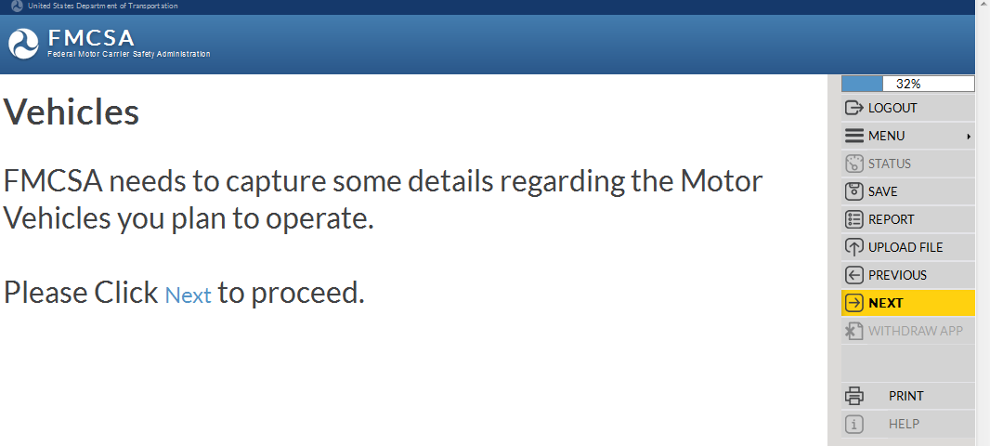
Vehicles
Some of the questions in the following section may or may not display in the URS Online Application Process.
The questions display based on the answers selected or entered by the Applicant.
FMCSA needs to capture details regarding the Motor Vehicles being planned to operate:
Number of non-CMVs
Type of CMVs
Number of CMVs operating in Canada or Mexico
Number of CMVs that will operate in Canada or Mexico
Number of CMVs that will operate in Interstate commerce
Number of CMVs that will operate in Intrastate commerce
Notes:
Vehicles.
Some of the questions in the following section may or may not display in the URS Online Application Process.
The questions display based on the answers selected or entered by the Applicant.
FMCSA needs to capture details regarding the Motor Vehicles being planned to operate.
This includes the following information:
Number of non-CMVs
Type of CMVs
Number of CMVs operating in Canada or Mexico
Number of CMVs that will operate in Canada or Mexico
Number of CMVs that will operate in Interstate commerce
Number of CMVs that will operate in Intrastate commerce
Click Next in the Navigation Menu to move to the next page.

Slide 19
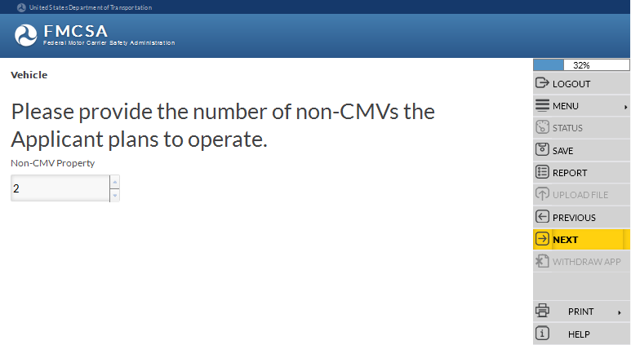
Vehicles (Cont.)
Provide the number of non-Commercial Motor Vehicles (CMV) the Applicant plans to operate.
Enter or use the up or down arrows to select a number
Notes:
Please provide the number of non-Commercial Motor Vehicles the Applicant plans to operate.
Enter or use the up or down arrows to provide the number of Non-CMV(s) for property. Enter ‘0’ if there are no vehicles.
Click Next in the Navigation Menu to move to the next page.

Slide 20
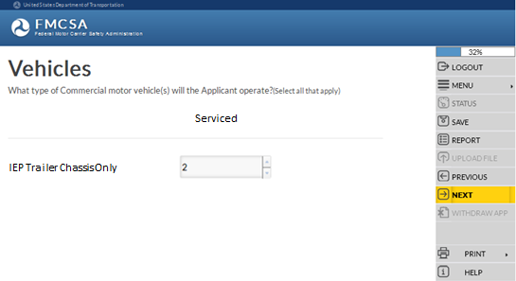
Vehicles (Cont.)
What type of Commercial motor vehicle(s) will the Applicant operate (select all that apply)?
Enter or use the up or down arrows to select a number
Notes:
What type of Commercial motor vehicle(s) will the Applicant operate (select all that apply)?
Enter or use the up or down arrows to provide the number of vehicles planned to operate. Enter ‘0’ if the vehicle type doesn’t apply.
Click Next in the Navigation Menu to move to the next page.

Slide 21
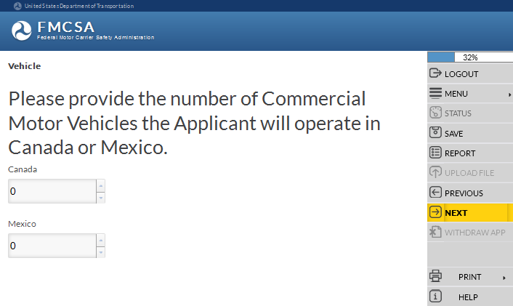
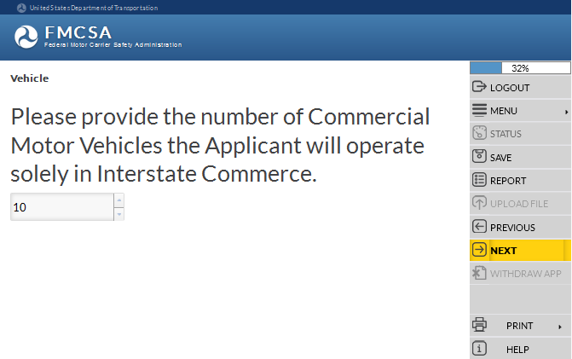
Vehicles (Cont.)
Provide the number of CMV(s) the Applicant will operate in Canada or Mexico.
Provide the number of CMVs the Applicant will operate solely in Interstate Commerce.
Enter or use the up or down arrows to select a number
Enter or use the up or down arrows to select a number
Notes:
Provide the number of CMV(s) the Applicant will operate in Canada or Mexico.
Enter or use the up or down arrows to provide the number of CMV(s) the Applicant will operate in Canada or Mexico. Enter ‘0’ if there are no CMVs.
Click Next in the Navigation Menu to move to the next page.
Provide the number of CMVs the Applicant will operate solely in Interstate Commerce.
Enter or use the up or down arrows to provide the number of CMV(s) the Applicant will operate in solely in Interstate Commerce. Enter ‘0’ if there are no CMVs.
Click Next in the Navigation Menu to move to the next page.

Slide 22
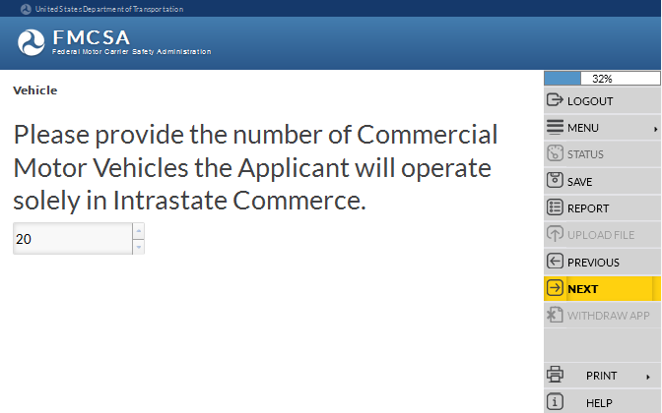
Vehicles (Cont.)
Provide the number of CMVs the Applicant will operate solely in Intrastate Commerce.
Enter or use the up or down arrows to select a number
Notes:
Provide the number of CMVs the Applicant will operate solely in Intrastate Commerce.
Enter or use the up or down arrows to provide the number of CMV(s) the Applicant will operate in solely in Intrastate Commerce. Enter ‘0’ if there are no CMVs.
Click Next in the Navigation Menu to move to the next page.

Slide 23
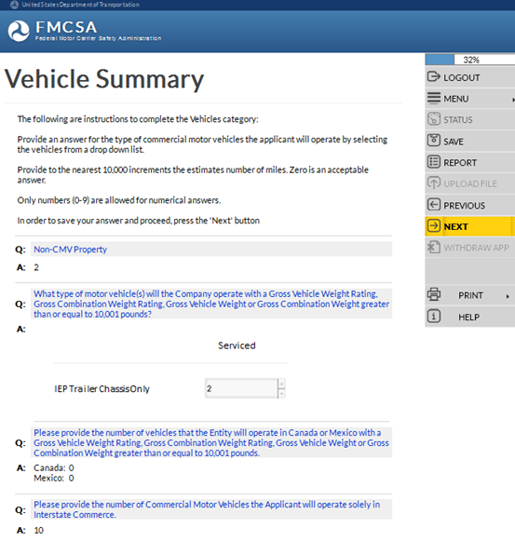
Vehicles (Cont.)
Review the Vehicles Summary to ensure the answers provided are correct
To change an answer, click the question text
To edit an answer click the question text
Notes:
Review the Vehicles Summary of questions and answers to ensure the information provided is correct.
To edit the answer to a question, click the question text to return to the question.
Click Next in the Navigation Menu to move to the next page.

Slide 24
Drivers
FMCSA needs to capture details regarding the type of drivers the Applicant will utilize:
Number of drivers operating as Interstate
Number of drivers operating solely as Intrastate
Number of drivers with a CDL, Licencia Federal de Conductor (LFC), or a valid Canadian License Class 1, 2, 3, or 4 (or Class A, B, C, or D if licensed in Ontario)
Some of the questions in the following section may or may not display in the URS Online Application Process.
The questions display based on the answers selected or entered by the Applicant.
Number of drivers operating in Canada or Mexico
Notes:
Drivers.
Some of the questions in the following section may or may not display in the URS Online Application Process.
The questions display based on the answers selected or entered by the Applicant.
FMCSA needs to capture details about the drivers the Applicant will be using in its operations.
This includes the following information:
Number of drivers operating as Interstate
Number of drivers operating solely as Intrastate
Number of drivers with a CDL, Licencia Federal de Conductor (LFC), or a valid Canadian License Class 1, 2, 3, or 4 (or Class A, B, C, or D if licensed in Ontario)
Number of drivers operating in Canada or Mexico
Click Next in the Navigation Menu to move to the next page.

Slide 25
Drivers (Cont.)
This question will display only for U.S. domiciled Motor Carriers
What are the number of drivers who will operate as Interstate?
Within a 100 Air-Mile Radius
Beyond a 100 Air-Mile Radius
What are the number of drivers who will operate solely as Intrastate?
Within a 100 Air-Mile Radius
Beyond a 100 Air-Mile Radius
Notes:
What are the number of drivers who will operate as Interstate?
Within a 100 Air-Mile Radius
Beyond a 100 Air-Mile Radius
Enter or use the up or down arrows to provide the number of drivers who will operate in Interstate Commerce within or beyond a 100 Air-Mile Radius. Enter ‘0’ if there are no drivers.
Click Next in the Navigation Menu to move to the next page.
This question will display only for U.S. domiciled Motor Carriers.
What are the number of drivers who will operate solely as Intrastate?
Within a 100 Air-Mile Radius
Beyond a 100 Air-Mile Radius
Enter or use the up or down arrows to provide the number of drivers who will operate solely in Intrastate Commerce within or beyond a 100 Air-Mile Radius. Enter ‘0’ if there are no drivers.
Click Next in the Navigation Menu to move to the next page.

Slide 26
Drivers (Cont.)
This question will NOT display for U.S. domiciled Motor Carriers
This question will display only for U.S. domiciled Motor Carriers
What are the number of drivers with a Commercial Driver's License (CDL), Licencia Federal de Conductor (LFC), or a valid Canadian License Class 1, 2, 3, or 4 (or Class A, B, C, or D if licensed in Ontario)?
What are the number of drivers who will operate in Canada or Mexico?
Notes:
This question will NOT display for U.S. domiciled Motor Carriers.
What are the number of drivers with a Commercial Driver's License (CDL), Licencia Federal de Conductor (LFC), or a valid Canadian License Class 1, 2, 3, or 4 (or Class A, B, C, or D if licensed in Ontario)?
Enter or use the up or down arrows to provide the number of drivers. Enter ‘0’ if there are no drivers.
This question will display only for U.S. domiciled Motor Carriers.
What are the number of drivers who will operate in Canada or Mexico?
Enter or use the up or down arrows to provide the number of drivers who will operate in Canada or Mexico. Enter ‘0’ if there are no drivers.
Click Next in the Navigation Menu to move to the next page.

Slide 27
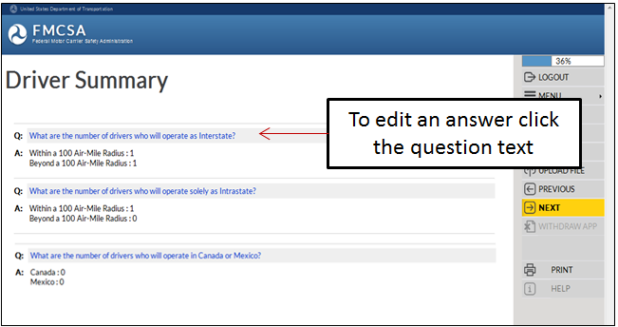
Drivers (Cont.)
Review the Drivers Summary to ensure the answers provided are correct
To change an answer, click the question text
Notes:
Review the Drivers Summary of questions and answers to ensure the information provided is correct.
To edit the answer to a question, click the question text to return to the question.
Click Next in the Navigation Menu to move to the next page.

Slide 28
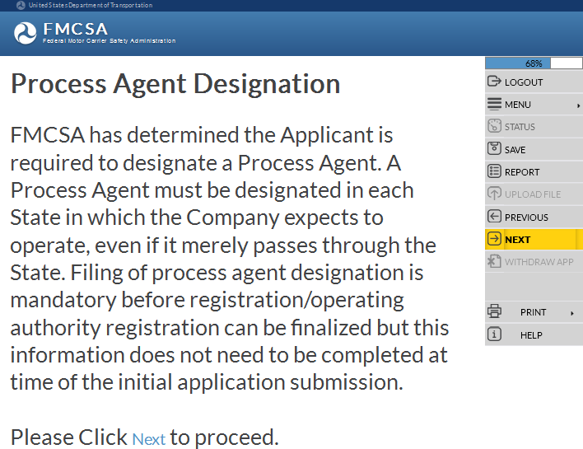
Process Agent Designation
FMCSA has determined the Applicant is required to designate a Process Agent:
Select a Process Agent Service
Contact the Process Agent Service to electronically file the Process Agent Designation document with FMCSA
It’s the Applicant responsibility to ensure the Process Agent Service electronically files the Process Agent Designation documentation within 90 days from the date of this application
For detailed information on this application section, reference the training module: “Introduction to Submit an Application for New Registration”
Notes:
Process Agent Designation.
FMCSA has determined the Applicant is required to designate a Process Agent. A Process Agent must be designated in each State in which the Company expects to operate, even if it merely passes through the State. Filing of process agent designation is mandatory before registration/operating authority registration can be finalized but this information does not need to be completed at time of the initial application submission.
For more detailed information about the Process Agent Designation section of the application, reference the training module: “Introduction to Submit an Application for New Registration”.
Select the information and click Next in the Navigation Menu to move to the next page.

Slide 29
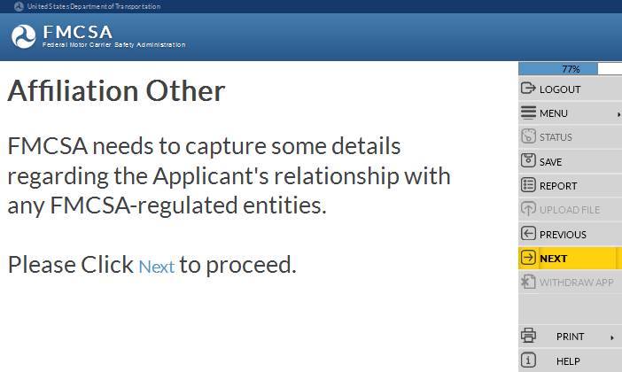
Affiliation with Others
For detailed information on this application section, reference the training module: “Introduction to Submit an Application for New Registration”
FMCSA needs to capture details regarding the Applicant’s relationship with any FMCSA-regulated entities:
If the Applicant has had within the last 3 years of the date of filing this application relationships involving common stock, ownership, management, control or familial relationships or any other person(s) or applicant for registration provide the Entity’s USDOT Number
Notes:
Affiliation with Others.
FMCSA needs to capture some details regarding the Applicant's relationship with any FMCSA-regulated entities.
If the Applicant has had within the last 3 years of the date of filing this application relationships involving common stock, ownership, management, control or familial relationships or any other person(s) or applicant for registration provide the Entity’s USDOT Number.
For more detailed information about the Affiliation with Others section of the application, reference the training module: “Introduction to Submit an Application for New Registration”.
Enter the information and click Next in the Navigation Menu to move to the next page.

Slide 30
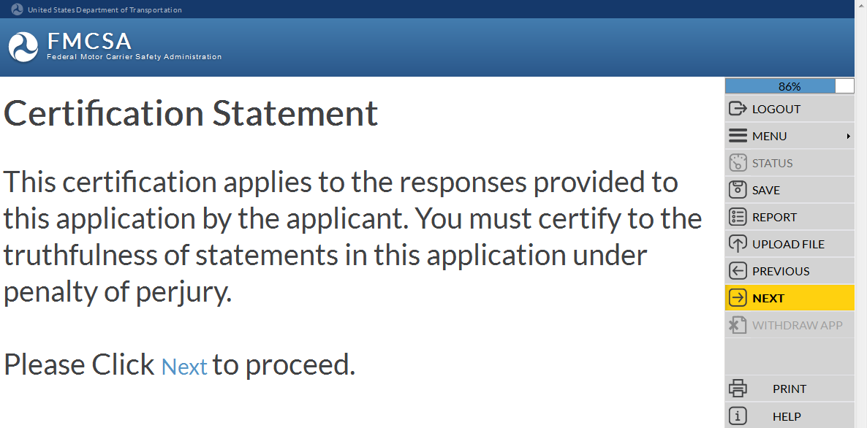
Certification Statement
This certification applies to the responses provided to this application by the Applicant
The Applicant must certify to the truthfulness of statements in this application under penalty of perjury
For detailed information on this application section, reference the training module: “Introduction to Submit an Application for New Registration”
Notes:
Certification Statement.
This certification applies to the responses provided to this application by the Applicant.
The Applicant must certify to the truthfulness of statements in this application under penalty of perjury.
For more detailed information about the Certification Statement section of the application, reference the training module: “Introduction to Submit an Application for New Registration”.
Enter the information and click Next in the Navigation Menu to move to the next page.

Slide 31
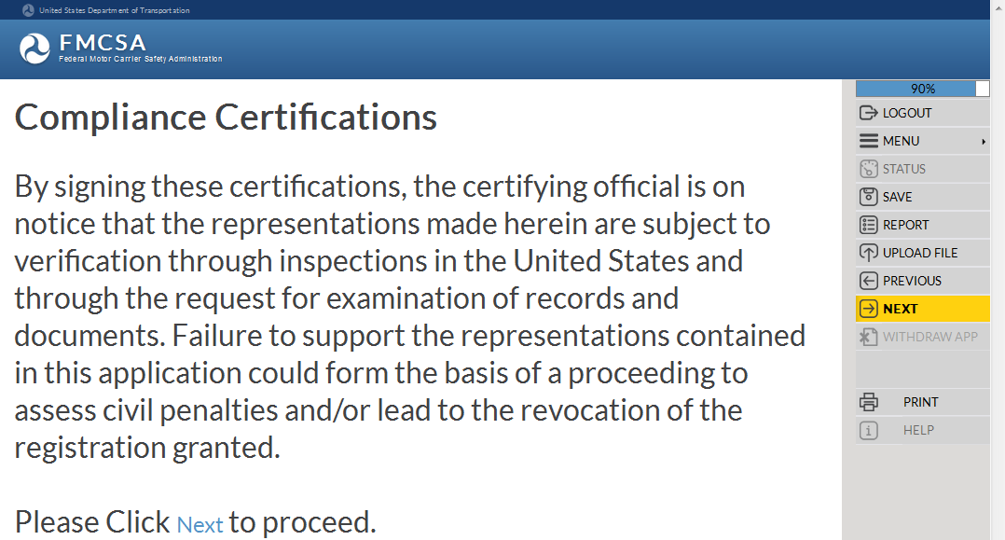
Compliance Certifications
Signing the certifications, the Certifying Official is on notice the representations made are subject to verification through inspections in the U.S. and through the request for examination of records and document
For detailed information on this application section, reference the training module: “Introduction to Submit an Application for New Registration”
Failure to support the representations in this application could form the basis of a proceeding to assess civil penalties and/or lead to the revocation of the registration granted
Notes:
Compliance Certifications.
By signing these certifications, the certifying official is on notice that the representations made herein are subject to verification through inspections in the United States and through the request for examination of records and documents.
Failure to support the representations contained in this application could form the basis of a proceeding to assess civil penalties and/or lead to the revocation of the registration granted.
For more detailed information about the Compliance Certifications section of the application, reference the training module: “Introduction to Submit an Application for New Registration”.
Enter the information and click Next in the Navigation Menu to move to the next page.

Slide 32
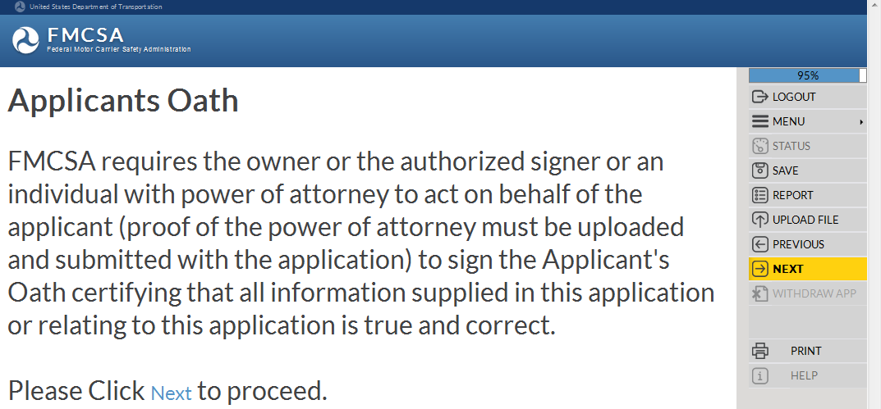
Applicant’s Oath
FMCSA requires the Owner or the Authorized Signer or an individual with power of attorney to act on behalf of the Applicant to sign the Applicant’s Oath certifying all information supplied in this application or relating to this application is true and correct
For detailed information on this application section, reference the training module: “Introduction to Submit an Application for New Registration”
Notes:
Applicant’s Oath.
FMCSA requires the owner or the authorized signer or an individual with power of attorney to act on behalf of the applicant (proof of the power of attorney must be uploaded and submitted with the application) to sign the Applicant's Oath certifying that all information supplied in this application or relating to this application is true and correct.
For more detailed information about the Applicant’s Oath section of the application, reference the training module: “Introduction to Submit an Application for New Registration”.
Enter the information and click Next in the Navigation Menu to move to the next page.

Slide 33
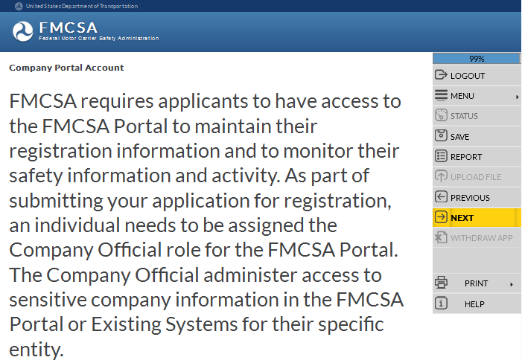
URS Company Official Portal Account
Applicants are required to have FMCSA Portal access to maintain their registration information and to monitor their safety information and activity
An individual needs to be assigned the Company Official role for the FMCSA Portal
For detailed information on this application section, reference the training module: “URS Company Official Portal Account”
Notes:
URS Company Official Portal Account.
FMCSA requires applicants to have access to the FMCSA Portal to maintain their registration information and to monitor their safety information and activity.
As part of submitting the application for registration, an individual needs to be assigned the Company Official role for the FMCSA Portal.
The Company Official administers access to sensitive company information in the FMCSA Portal or Existing Systems for their specific entity.
For more detailed information about the FMCSA Portal Company Official Account section of the application, reference the training module: “URS Company Official Portal Account”.
Click Next in the Navigation Menu to move to the next page.

Slide 34
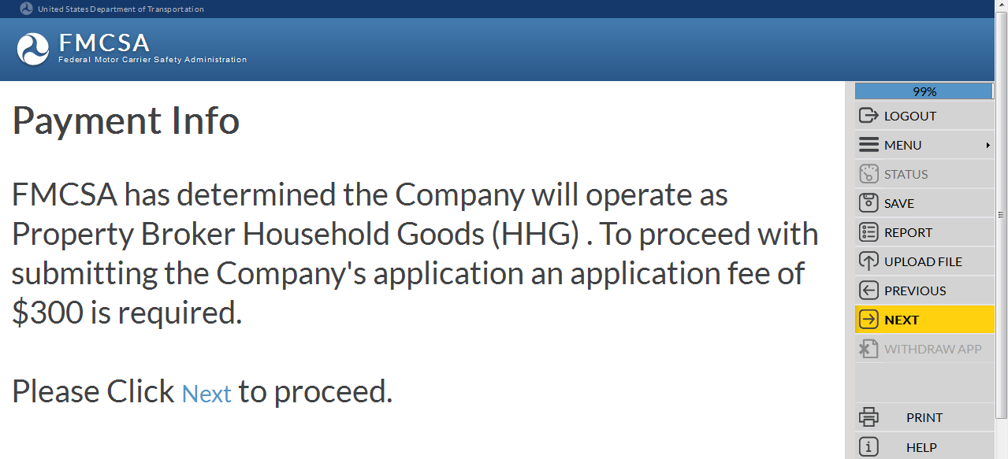
Payment Information
Operation Classification(s) determines the Applicant's required application fee dollar amount
FMCSA does NOT refund filing fees
Filing fees must be payable to the FMCSA, by a U.S. EFT or a credit card
For detailed information on this application section, reference the training module: “Introduction to Submit an Application for New Registration”
FMCSA has determined the Applicant will operate as an Intermodal Equipment Provider (IEP). To proceed with submitting the Applicant’s application no application fee is required.
Applications aren’t processed until the payment has been deducted from a bank or credit card account
Notes:
Payment Information.
Based on the Operation Classification(s), FMCSA determines the Applicant's required application fee dollar amount.
FMCSA does not refund filing fees
Your filing fees must be payable to the FMCSA, by Electronic Funding Transfer (EFT), or by an approved credit card
EFT must be from an account in a bank in the United States
Fees are required for each type of registration requested. For example, if applicant wishes to be registered as both a motor carrier and a broker, applicant may file a single application and make a single payment of $600.
FTA grantees do not pay a fee to file an application for registration
FMCSA will not process an applicant’s application until the payment has been deducted from his/her banking or credit card account
Creation of a FMCSA application does not guarantee access to the FMCSA Portal Account
For more detailed information about the Payment Information section of the application, reference the training module: “Introduction to Submit an Application for New Registration”.
Click Next in the Navigation Menu to move to the next page.

Slide 35
End of the Training Module
End of the Training Module
Please Close the Browser Window
Notes:
This is the end of the training module, please close the browser window.

