Slide 1
Introduction to the URS Online Application Process to Request a FMCSA Portal Company Official Account
Unified Registration System (URS)
URS New Application Release for First-Time Applicants, December 2015 v1.0
Notes:
Unified Registration System (URS).
Introduction to the URS Online Application Process to Request a FMCSA Portal Company Official Account.

Slide 2
Training Objectives
Prerequisite: Completion of the training module titled ‘Introduction to Submit an Application for New Registration’
Provide Applicants an overview for using the URS Online Application Process to request a FMCSA Portal Company Official Account
The functionality in this module includes the following:
Completing the Company Official Information
Reviewing and Acknowledging Statements
Notes:
Training Objectives.
The prerequisite for this training module is the completion of the training module titled ‘Introduction to Submit an Application for New Registration’ .
The training objective is to provide Applicants an overview for using the URS Online Application Process to request a FMCSA Portal Company Official Account.
The functionality in this module includes the following:
Completing the Company Official Information
Reviewing and Acknowledging Statements

Slide 3
Requesting a FMCSA Portal Company Official Account
The URS Online Application Process streamlines the Portal Company Official Account Request Process by providing the following functionality:
An automated self-service process
Providing the capability for Applicants to identify Company Officials
Providing the capability for Applicants to specify the Company Official’s User ID and Password
Notes:
Requesting a FMCSA Portal Company Official Account.
The URS Online Application Process streamlines the Portal Company Official Account Request Process by providing the following functionality:
An automated self-service process
Providing the capability for Applicants to identify Company Officials
Providing the capability for Applicants to specify the Company Official’s User ID and Password

Slide 4
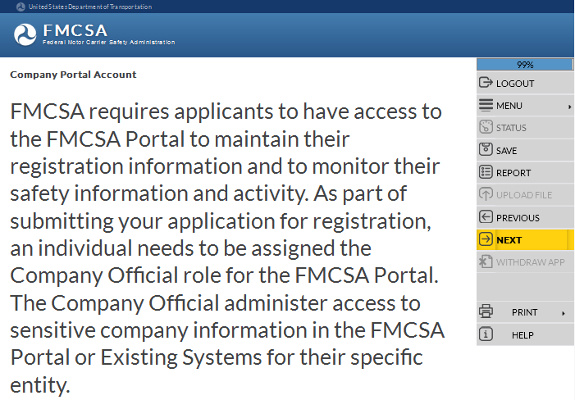
Requesting a FMCSA Portal Company Official Account (Cont.)
Applicants are required to have FMCSA Portal access to maintain their registration information and to monitor their safety information and activity
An individual needs to be assigned the Company Official role for the FMCSA Portal
Company Official administers access to sensitive company information
Notes:
FMCSA requires Applicants to have access to the FMCSA Portal to maintain their registration information and to monitor their safety information and activity.
As part of submitting the application for registration, an individual needs to be assigned the Company Official role for the FMCSA Portal.
The Company Official administers access to sensitive company information in the FMCSA Portal or Existing Systems for their specific entity.
Click Next in the Navigation Menu to move to the next page.

Slide 5
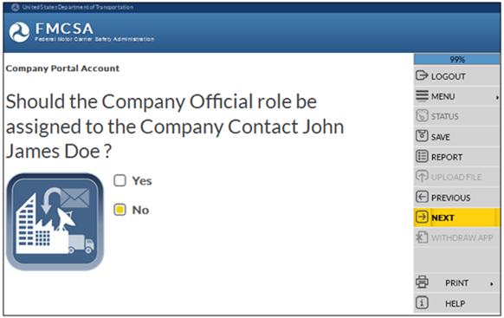
Requesting a FMCSA Portal Company Official Account (Cont.)
Should the Company Official role be assigned to the Company Contact?
If the Company Official role should be assigned to the Company Contact, select the Yes box. If not, select the No box.
Company Contact’s Name will display based on the information provided in the URS Online Application Process, Business Description section
Select Yes or No
Notes:
Should the Company Official role be assigned to the Company Contact?
If the Company Official role should be assigned to the Company Contact, select the Yes box.
If the Company Official role should NOT be assigned to the Company Contact, select the No box. The system will guide you to the next question asking to provide the Company Official information.
The Company Contact Name will populate based on the information provided in the URS Online Application Process, Business Description section.
Click Next in the Navigation Menu to move to the next page.

Slide 6
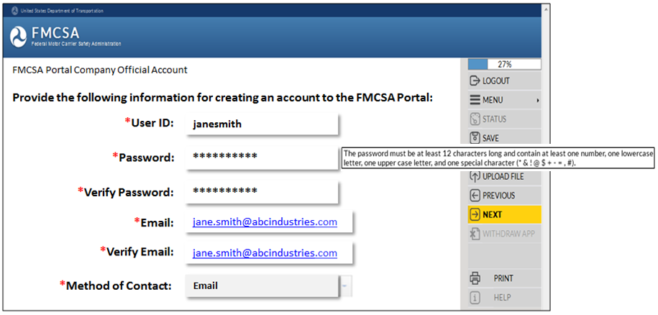
Requesting a FMCSA Portal Company Official Account (Cont.)
If Yes, the Company Official role should be assigned to the Company Contact, provide the information for creating an account to the FMCSA Portal
Enter a User ID and a Password following the Password Requirements
Enter the Email Address and re-enter it to verify
Use the drop down arrow to select a preferred method for FMCSA to contact the Company Official
Notes:
If Yes, the Company Official role should be assigned to the Company Contact, provide the information for creating an account to the FMCSA Portal.
User ID
Password
Enter a Password using the Password Requirements
Verify the Password
Email
Verify Email
Method of Contact: Email, US Mail or Both
Click Next in the Navigation Menu to move to the next page.

Slide 7
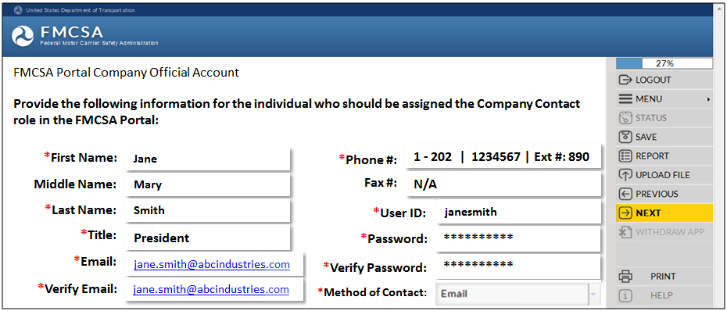
Requesting a FMCSA Portal Company Official Account (Cont.)
If No, the Company Official role should NOT be assigned to the Company Contact, provide the information for the individual who should be assigned the Company Official role in the FMCSA Portal
Enter all the information for the individual who should be assigned the Company Official role
Notes:
If No, the Company Official role should NOT be assigned to the Company Contact, provide the information for the individual who should be assigned the Company Official role in the FMCSA Portal.
Enter all the required information:
First Name
Middle Name
Last Name
Title
Email Address
Verify the Email Address
Telephone Number
Phone Extension (if applicable)
Fax Number (if applicable)
User ID
Password
Enter a Password using the Password Requirements
Verify the Password
Method of Contact: Email, US Mail or Both
Click Next in the Navigation Menu to move to the next page.

Slide 8
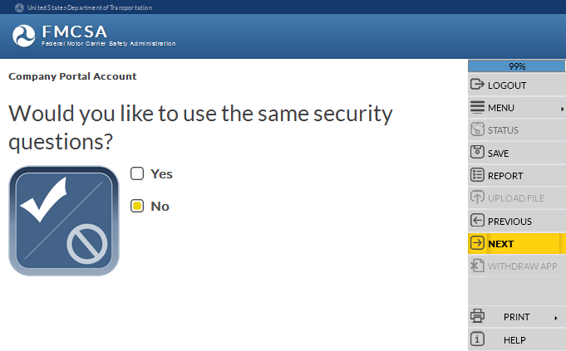
Requesting a FMCSA Portal Company Official Account (Cont.)
Would you like to reuse the same Security Questions selected during the URS Online Application Process, Application Security section?
If you want to reuse the same Security Questions and Security Answers, select the Yes box
If you want to select NEW Security Questions and Security Answers select the No box
Select Yes or No
Notes:
If you want to reuse the Security Questions and Security Answers selected during the URS Online Application Process, Application Security section, select the Yes box.
If you want to select NEW Security Questions and Security Answers select the No box. The system will guide you to the option to select new Security Questions and to provide new Security Answers.
Click Next in the Navigation Menu to move to the next page.

Slide 9
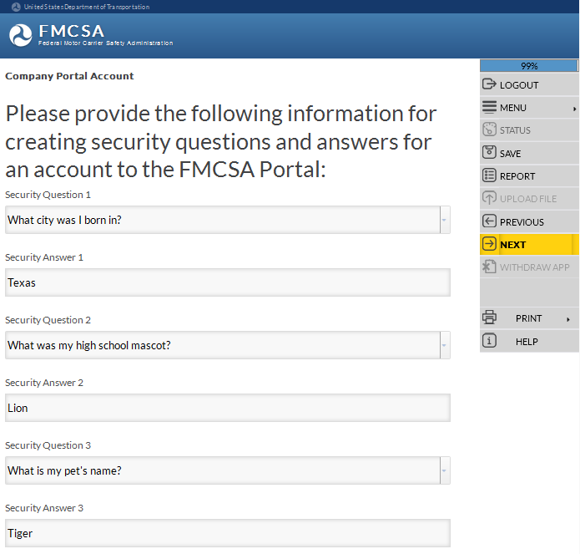
Requesting a FMCSA Portal Company Official Account (Cont.)
If you want to select NEW Security Questions and Security Answers, use the drop down arrow and select three Security Questions and provide the Security Answers in the blank fields
Use the drop down arrow to view the Security Questions and select a question from the list
Enter a Security Answer in the blank field
Notes:
If you selected to provide NEW Security Questions and Security Answers, use the drop down arrow to view the different questions.
Select three Security Questions and provide the Security Answers in the blank fields.
Click Next in the Navigation Menu to move to the next page.

Slide 10
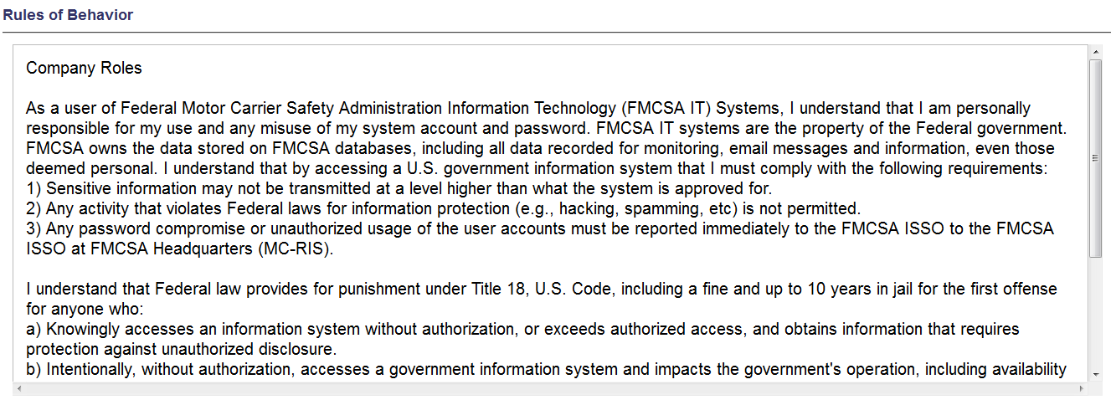
Requesting a FMCSA Portal Company Official Account (Cont.)
Read the FMCSA Portal Rules of Behavior
Use the scroll bar to view more of the Rules of Behavior
Notes:
Read the FMCSA Portal Rules of Behavior.
Use the scroll bar to view more of the Rules of Behavior.

Slide 11
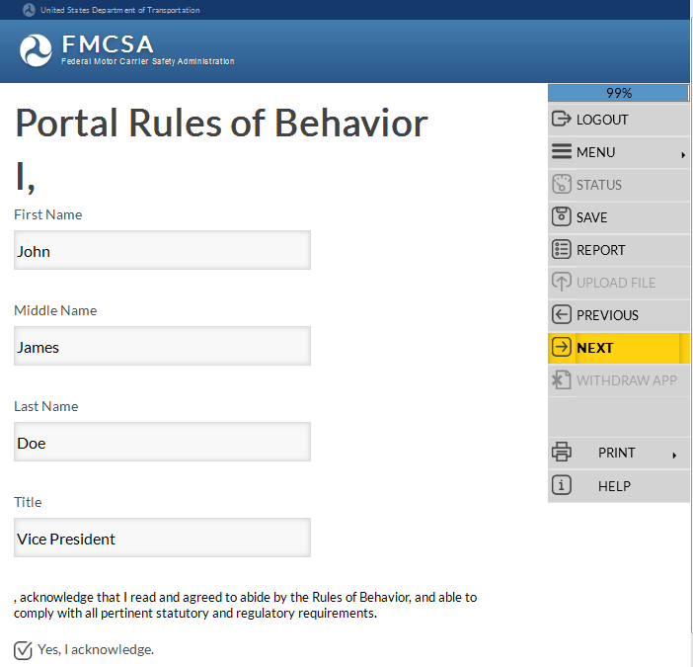
Requesting a FMCSA Portal Company Official Account (Cont.)
Acknowledge you agree to abide by the FMCSA Portal Rules of Behavior and comply with all statutory and regulatory requirements
Enter your First, Middle, Last Name and Title
Select the box to acknowledge you agree
Notes:
Acknowledge you agree to abide by the FMCSA Portal Rules of Behavior and comply with all statutory and regulatory requirements.
I acknowledge that I read and agreed to abide by the Rules of Behavior, and able to comply with all pertinent statutory and regulatory requirements.
Select the box to acknowledge you agree.
Enter your First, Middle, Last Name and Title.
Click Next in the Navigation Menu to move to the next page.

Slide 12
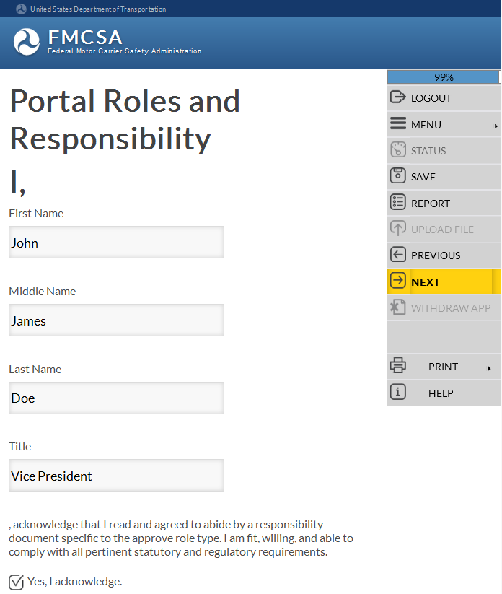
Requesting a FMCSA Portal Company Official Account (Cont.)
Acknowledge you have read and agree to abide by a responsibility document specific to the Company Official role
Enter your First, Middle, Last Name and Title
Select the box to acknowledge you agree
Notes:
Acknowledge you have read and agree to abide by a responsibility document specific to the Company Official role.
I acknowledge that I read and agree to abide by a responsibility document specific to the approve role type. I am fit, willing, and able to comply with all pertinent statutory and regulatory requirements.
Select the box to acknowledge you agree.
Enter your First, Middle, Last Name and Title.
Click Next in the Navigation Menu to move to the next page.

Slide 13
Request a Portal Account - Confirmation
When successfully completed an Account Request Confirmation will be emailed to the address provided.
Note: The confirmation email may go to the Requestor’s ‘Spam’ or ‘Junk’ folder
Company Official account requests are automatically approved upon submission of the application for registration
Company Officials can immediately login to the FMCSA Portal using the User Id and Password they requested on the application for registration
Notes:
When successfully completed an Account Request Confirmation will be emailed to the address provided.
Note: The confirmation email may go to the Requestor’s ‘Spam’ or ‘Junk’ folder.
Company Official account requests are automatically approved upon submission of the application for registration.
Company Officials can immediately login to the FMCSA Portal using the User Id and Password they requested on the application for registration.

Slide 14
End of the Training Module
End of Training Module
Please Close the Browser Window
Notes:
End of the Training Module. Please close the browser window.

