Slide 1
Unified Registration System (URS)
U.S. and Canada:
Introduction to Submit an Application for New Registration
URS New Application Release for First-Time Applicants, January 2016, v1.1
Notes:
Unified Registration System (URS).
United State and Canada: Introduction to Submit an Application for New Registration.

Slide 2
Training Objectives
Provide an overview to submit an application for new registration using the URS Online Application Process
The functionality in this module includes the following:
Introduction to the URS Online Application Process
Completing the application for new registration
Reviewing and submitting payment for the application
Uploading documents to submit with the application
Printing the application
Returning to complete an incomplete application
Notes:
Training Objectives.
The training objective for this module is to provide an overview to submit an application for New Registration using the URS Online Application Process.
The functionality in this module includes the following:
Introduction to the URS Online Application Process
Completing the application for new registration
Reviewing and submitting payment for the application for new registration
Uploading documents to submit with the application for new registration
Printing the application for new registration
Returning to complete an incomplete application

Slide 3
Introduction to the URS Online Application Process
The URS Online Application Process provides the following functionality:
Asks questions using an interview style format
Displays questions based on the Applicant’s responses
Ability to upload documents for submission with the application
Displays a summary of the questions and answers
Ability to update previously completed sections of the application
Ability to save an incomplete application, providing 30 calendar days to return and complete the incomplete application
Ability to print the application at any point
Notes:
Introduction to the URS Online Application Process.
The URS Online Application Process provides the following functionality:
Asks questions using an interview style format
Displays questions based on the Applicant’s responses
Ability to upload documents for submission with the application
Displays a summary of the questions and answers for the Applicant to review
Ability to update previously completed sections of the application
Ability to save an incomplete application for future editing, providing 30 calendar days to return and complete the incomplete application
Ability to print the application at any point

Slide 4
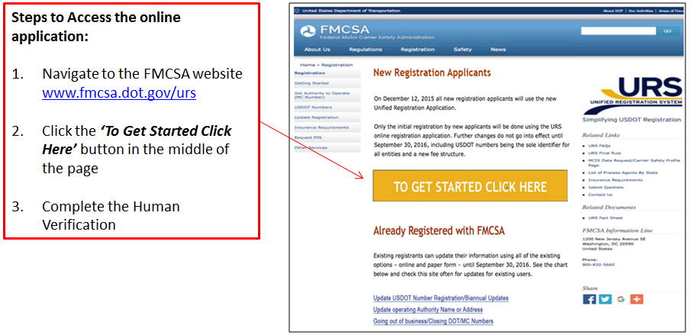
Accessing the URS Online Application Process
To apply for New Registration the URS Online Application Process can be accessed from the FMCSA Website, www.fmcsa.dot.gov/urs
Notes:
Accessing the URS Online Application Process.
To apply for New Registration the URS Online Application Process can be accessed from the FMCSA Website, www.fmcsa.dot.gov/urs.
These are the steps to access the online application:
Navigate to the FMCSA Website
Click the “To Get Started Click Here” button in the middle of the page
Completed the Human Verification

Slide 5
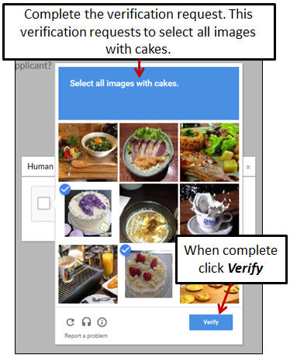
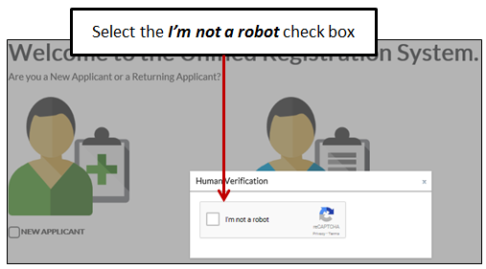
Accessing the URS Online Application Process (Cont.)
Before accessing the application the Applicant will need to provide Human Verification
Select the check box I’m not a robot
Complete the verification request
Notes:
Before accessing the application the Applicant will need to provide Human Verification.
Select the check box I’m not a robot
Complete the verification request
When complete, click Verify

Slide 6
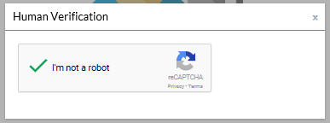
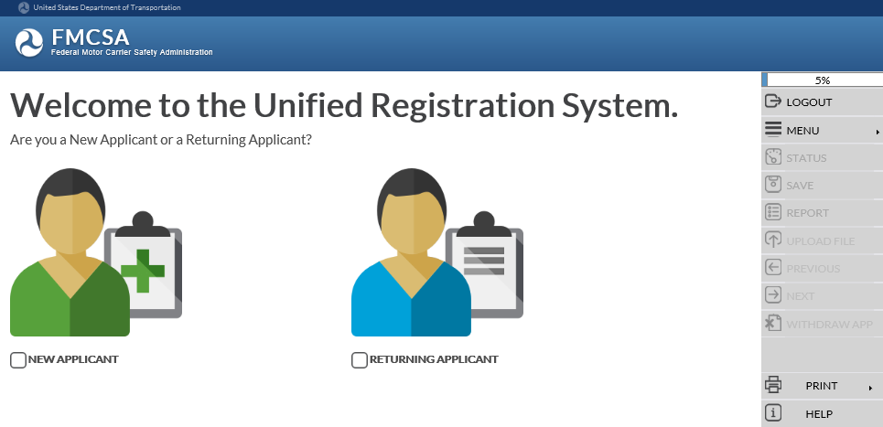
Accessing the URS Online Application Process (Cont.)
The system will display a green check mark confirming the human verification
The system will display the URS Welcome Page
Notes:
The system will display a green check mark confirming the human verification.
The system will display the URS Welcome page.

Slide 7
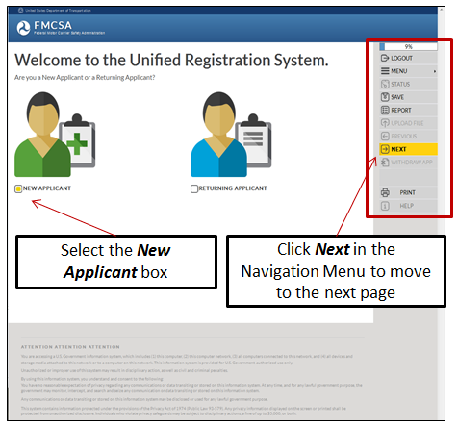
Welcome Page
Applicants applying for New Registration select the New Applicant box under the green avatar on the left side of the page
When all the information on a page has been provided, the Next button in the Navigation Menu on the right side of the page will display yellow
Click Next in the Navigation Menu to move to the next page
Notes:
Welcome Page.
The Welcome page provides the Applicant the option to choose New Applicant or Returning Applicant.
Applicants applying for New Registration select the New Applicant box under the green avatar on the left side of the page.
When all the information on a page has been provided, the Next option in the Navigation Menu on the right of the page will display yellow.
The Navigation Menu on the right side of the page will display throughout the URS Online Application Process.
Click Next in the Navigation Menu to move to the next page.

Slide 8
Navigation Menu
The Navigation Menu on the right side of the page will display throughout the entire URS Online Application Process and provides the following functionality:
Percent Complete Bar: A gauge to measure the amount of the application that has been completed
Logout: Select Logout to logout of the URS Online Application Process
Notes:
Navigation Menu.
The Navigation Menu on the right side of the page will display throughout the URS Online Application Process and provides the following functionality:
Percent Complete Bar: A gauge to measure the amount of the application that has been completed.
Logout: Select Logout to logout of the URS Online Application Process.

Slide 9
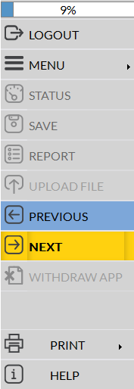
Navigation Menu (Cont.)
Menu: Select Menu to view the sections of the application that have been completed. To return to a completed section of the application click the name of section in the list.
Save: Select Save to save an incomplete application to be completed in the future
Report: Select Report to view and save the MCSA-1 form in PDF format
Upload File: Select Upload File to attach required or supporting documents to the application for submission
Notes:
Menu: Select Menu to view the sections of the application that have been completed. To return to a completed section of the application click the name of section in the list.
Save: Select Save to save an incomplete application to be completed in the future.
Report: Select Report to view and save the MCSA-1 form in PDF format.
Upload File: Select Upload File to attach required or supporting documents to the application for submission.

Slide 10
Navigation Menu (Cont.)
Previous: Select Previous to navigate to the previous page
Next: Select Next to navigate to the next page. When the system has validated all the information on a page has been provided it will display yellow ready for selection.
Print: Select Print to print the completed sections. Only the sections of the application where responses have been provided to the questions will be printed.
Help: Select Help to view additional informational about the content on the page
Click Next in the Navigation Menu to move to the next page.
Notes:
Previous: Select Previous to navigate to the previous page.
Next: Select Next to navigate to the next page. When the system has validated all the information on a page has been provided it will display yellow ready for selection.
Print: Select Print to print the completed sections. Only the sections of the application where responses have been provided to the questions will be printed.
Help: Select Help to view additional informational.
Click Next in the Navigation Menu to move to the next page.

Slide 11
How to Navigate the URS Online Application Process
The How to Navigate the URS Online Application Process page provides information on how to navigate through the online application to assist the Applicant in completing the application successfully
Click Next in the Navigation Menu or the bottom of the page to move to the next page
Notes:
How to Navigate the URS Online Application Process.
The How to Navigate the URS Online Application Process page provides information on how to navigate through the application to assist the Applicant in completing the application successfully.
Here are a few things to assist you in completing your application successfully:
Each application is assigned an Applicant ID. The applicant will have the capability of creating a password to associate with the Applicant ID. The Applicant ID and Password is temporary and is only for the purposes of completing this application.
A response is required for all questions that are asked.
Once a response has been selected, Click Next to proceed to the next question.
If you would like review or change a response to a question, Click Previous to view the previous question.
If you are unsure of the meaning of a question response, place your mouse on the response to see a definition.
At the end of each section you will be presented with a summary, containing a listing of the questions you were asked along with the response you provided. If you would like to modify a response to a question, click the question text.
Click Next in the Navigation Menu or the bottom of the page to move to the next page.

Slide 12
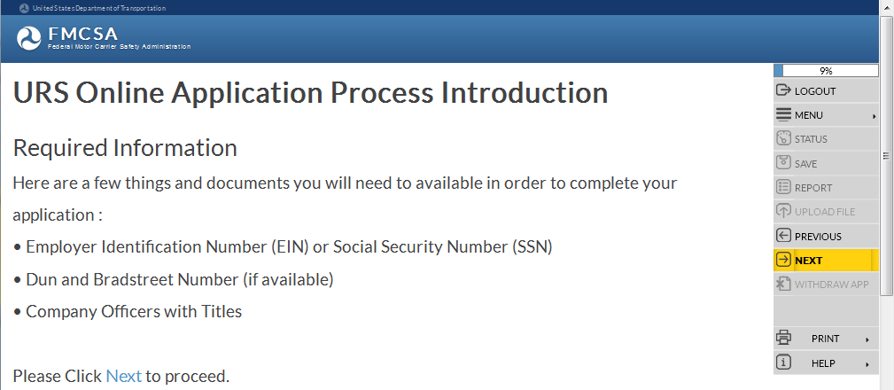
Required Information
The Required Information page provides a list of documents or information needed in order to complete the application for New Registration successfully
Notes:
Required Information. The Required Information page provides a list of documents or information needed in order to complete the application for New Registration successfully. Employer Identification Number (EIN) or Social Security Number Dun and Bradstreet Number (If available) Company Officers with Titles Click Next in the Navigation Menu or the bottom of the page to move to the next page.

Slide 13
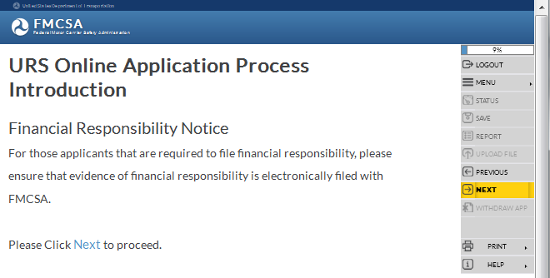
Financial Responsibility Notice
The Financial Responsibility Notice explains, for Applicants who are required to file evidence of financial responsibility, the Applicant must ensure the evidence is electronically filed with FMCSA
For Applicants required to file evidence of financial responsibility, the Applicant must ensure the evidence of financial responsibility is electronically filed with FMCSA before new registration is granted and an active USDOT Number is issued
Notes:
Financial Responsibility Notice.
The Financial Responsibility Notice explains, for Applicants who are required to file evidence of financial responsibility, the Applicant must ensure the evidence of financial responsibility is electronically filed with FMCSA before new registration is granted and an active USDOT Number is issued.
Click Next in the Navigation Menu or the bottom of the page to move to the next page.

Slide 14
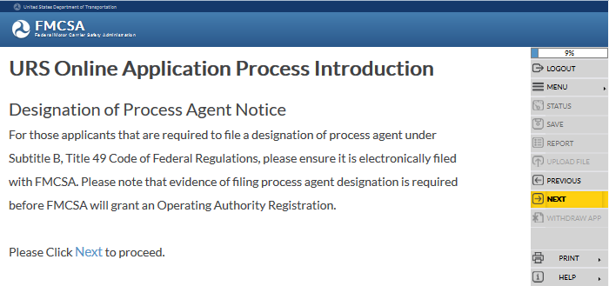
Designation of Process Agent Notice
The Designation of Process Agent Notice explains, for Applicants who are required to file designation of a process agent, the Applicant must ensure the designation of a process agent is electronically filed with FMCSA
For Applicants required to file designation of a process agent, the Applicant must ensure the designation of process agent is electronically filed with FMCSA before new registration is granted and an active USDOT Number is issued
Notes:
Designation of Process Agent Notice.
The Designation of Process Agent Notice explains, for all Applicants who are required to file a designation of process agent under Subtitle B, Title 49 Code of Federal Regulations, must ensure the designation of process agent is electronically filed with FMCSA before new registration is granted and an active USDOT Number is issued.
Click Next in the Navigation Menu or the bottom of the page to move to the next page.

Slide 15
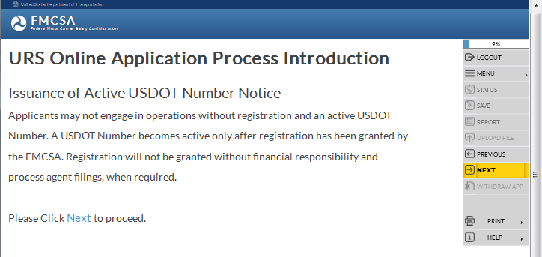
Issuance of Active USDOT Number Notice
The Issuance of Active USDOT Number Notice explains, Applicants may not engage in operations without registration and an active USDOT Number
USDOT Number becomes active after registration has been granted by the FMCSA
Registration won’t be granted without financial responsibility and process agent filings, when required
Notes:
Issuance of Active USDOT Number Notice.
The Issuance of Active USDOT Number Notice explains, Applicants may not engage in operations without registration and an active USDOT Number.
A USDOT Number becomes active only after registration has been granted by the FMCSA.
Registration will not be granted without financial responsibility and process agent filings, when required.
Click Next in the Navigation Menu or the bottom of the page to move to the next page.

Slide 16
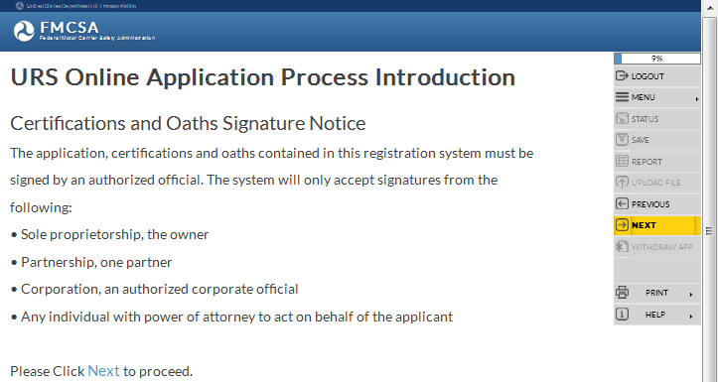
Certifications and Oaths Signature Notice
The Certifications and Oaths Signature Notice explains the application, certifications and oaths contained in this registration system must be signed by an authorized official
Only signatures from the following are accepted:
Sole proprietorship, the owner
Partnership, one partner
Corporation, an authorized corporate official
Any individual with power of attorney to act on behalf of the applicant
Notes:
Certifications and Oaths Signature Notice.
The Certifications and Oaths Signature Notice explains the application, certifications and oaths contained in this registration system must be signed by an authorized official. Only signatures from the following are accepted:
Sole proprietorship, the owner
Partnership, one partner
Corporation, an authorized corporate official
Any individual with power of attorney to act on behalf of the applicant
Click Next in the Navigation Menu or the bottom of the page to move to the next page.

Slide 17
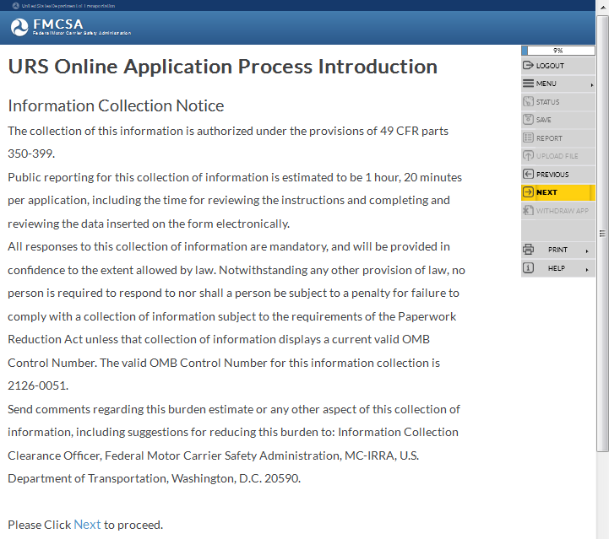
Information Collection Notice
The Information Collection Notice explains the collection of this information is authorized under the provisions of 49 CFR parts 350-399
Public reporting for the collection of information is estimated to be 1 hour, 20 minutes per application
All responses to this collection of information are mandatory
Notes:
Information Collection Notice.
The collection of this information is authorized under the provisions of 49 CFR parts 350-399.
Public reporting for this collection of information is estimated to be 1 hour, 20 minutes per application, including the time for reviewing the instructions and completing and reviewing the data inserted on the form electronically.
All responses to this collection of information are mandatory, and will be provided in confidence to the extent allowed by law. Notwithstanding any other provision of law, no person is required to respond to nor shall a person be subject to a penalty for failure to comply with a collection of information subject to the requirements of the Paperwork Reduction Act unless that collection of information displays a current valid OMB Control Number.
The valid OMB Control Number for this information collection is 2126-0051.
Send comments regarding this burden estimate or any other aspect of this collection of information, including suggestions for reducing this burden to: Information Collection Clearance Officer, Federal Motor Carrier Safety Administration, MC-IRRA, U.S. Department of Transportation, Washington, D.C. 20590.

Slide 18
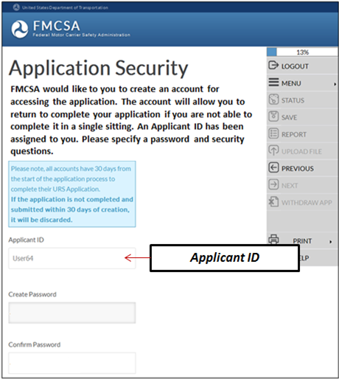
Application Security
The Application Security page is where FMCSA would like the Applicant to create an account for accessing the application
The account will allow the Applicant to return to complete the application if it’s not able to be completed in a single sitting
An Applicant ID has been system generated and assigned to the Applicant
Notes:
Application Security. FMCSA would like the Applicant to create an account for accessing the application. The account will allow the Applicant to return to complete the application if it’s not able to be completed in a single sitting. The URS Online Application Process will automatically assign and display a unique Applicant ID that has been assigned to the Applicant. A saved application must be completed within 30 calendar days of the saved date. The Applicant ID must be retained by the Applicant for future use.

Slide 19
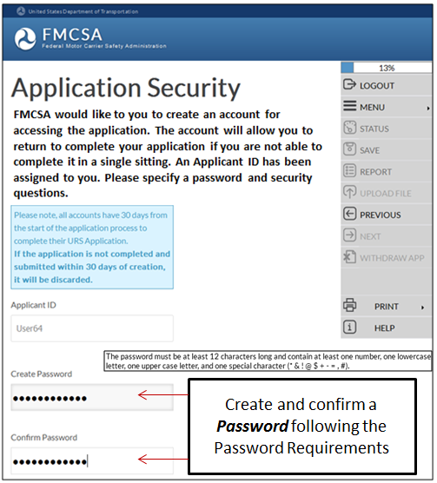
Application Security (Cont.)
Applicant ID and Password are temporary and used to login to complete an incomplete application
The Applicant will create a Password to associate with the Applicant ID
Create a Password and re-enter or Confirm the Password, following the Password Requirements
Notes:
The Applicant will create a password to associate with the Application ID.
The Applicant ID and Password are temporary and are only for the purpose of logging into the URS Online Application Process to complete a saved, incomplete application.
Create a Password and re-enter or Confirm the Password following the Password Requirements.
The Password Requirements will display while entering a password and the orange exclamation point will display at the end of the field.

Slide 20
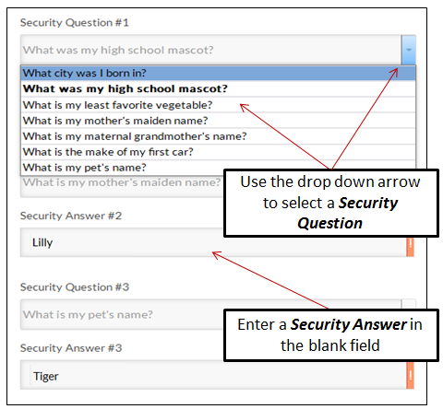
Application Security (Cont.)
The Applicant will need to select three Security Questions and provide the Security Answers to associate with the Applicant ID and Password
Use the drop down arrow to select three Security Questions and provide the Security Answers in the blank fields
Notes:
The Applicant will need to select three different Security Questions and provide the Security Answers in the blank fields
Use the drop down arrow to select three Security Questions and provide the Security Answers in the blank fields.

Slide 21
Application Security (Cont.)
Security Questions provide the ability for the Applicant to recover the Applicant ID or Password if forgotten
The Application Security page can be printed to retain the information for future use
Notes:
The Security Questions provide the ability for the Applicant to recover the Applicant ID or Password if forgotten.
The Application Security Page can be printed to retain the information for future use.
Click Next in the Navigation Menu to move to the next page.

Slide 22
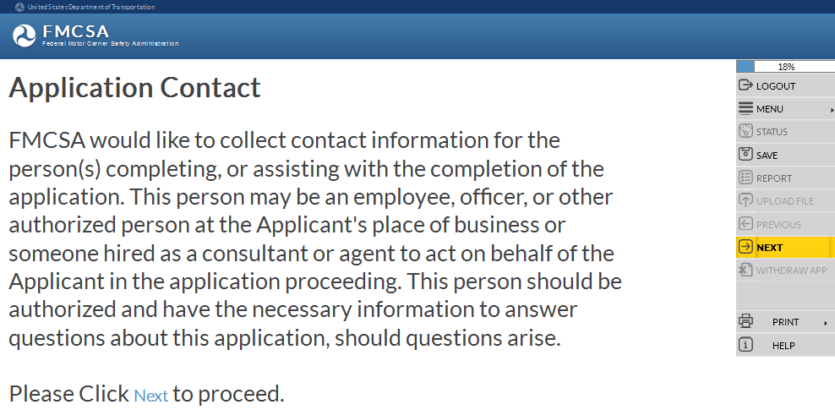
Application Contact
The Application Contact page is where FMCSA collects contact information from the person(s) completing, or assisting with the completion of the application
Person may be an employee, officer, or other authorized person at the Applicant's place of business or someone hired as a consultant or agent to act on behalf of the Applicant in the application proceeding
Notes:
Application Contact.
The Application Contact page is where FMCSA would like to collect contact information for the person(s) completing, or assisting with the completion of the application.
This person may be an employee, officer, or other authorized person at the Applicant's place of business or someone hired as a consultant or agent to act on behalf of the Applicant in the application proceeding.
This person should be authorized and have the necessary information to answer questions about this application, should questions arise.
Click Next in the Navigation Menu or the bottom of the page to move to the next page.

Slide 23
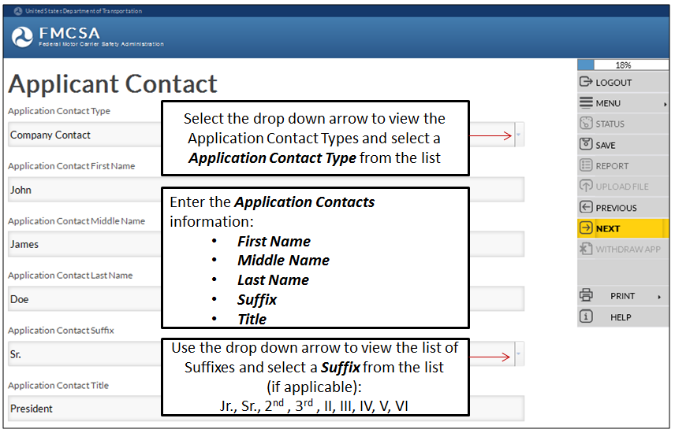
Application Contact (Cont.)
Enter the Application Contact’s information
Notes:
Enter the Application Contact Person information.
Select the drop down arrow to view a list of Application Contact Types. Select an Application Contact Type from the list:
Company Contact (e.g. Employer, Officer) – Person at the Applicant’s place of business who prepares the application for New Registration (Form MCSA-1), or otherwise assists in completing the application.
Applicant Representative (e.g. Consultant, Agent) – Someone other than the Applicant who is hired as a consultant, agent or representative that prepares the application for New Registration (Form MCSA-1), or otherwise assists the Applicant in completing the application.
Both the Company Contact and Applicant Representative may be contacted by FMCSA if there are questions concerning the application.
Enter the Application Contact persons information:
First Name
Middle Name
Last Name
Suffix, suffixes values include: Jr., Sr., 2nd , 3rd , II, III, IV, V, VI. Select the drop down arrow to view a list of Suffixes and select a Suffix from the list.
Title

Slide 24
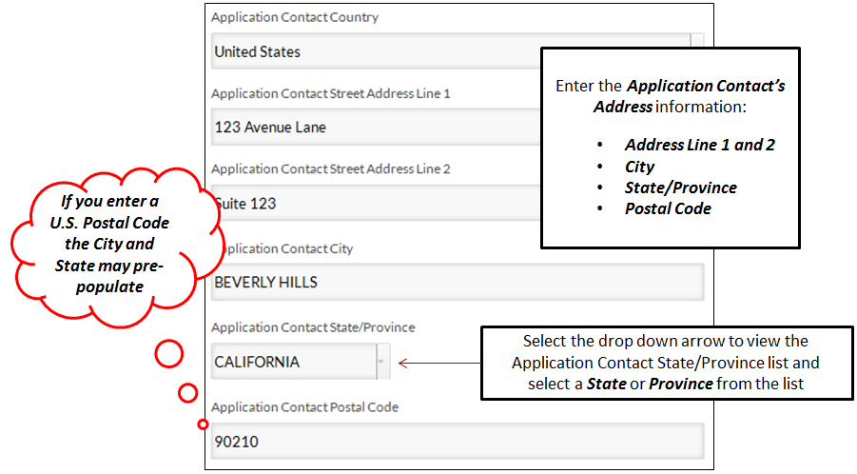
Application Contact (Cont.)
Notes:
Enter the Application Contact Address information. Enter the Application Contact Street Address in Line 1. Enter the Application Contact Street Address in Line 2, if needed. Note: If you enter a U.S. Postal Code, the City and State may automatically populate with the matching information. Enter the Application Contact City. Select the drop down arrow to view a list of Application Contact State/Provinces. Select the Application Contact State/Province from the list. Enter the Application Contact Postal Code.

Slide 25
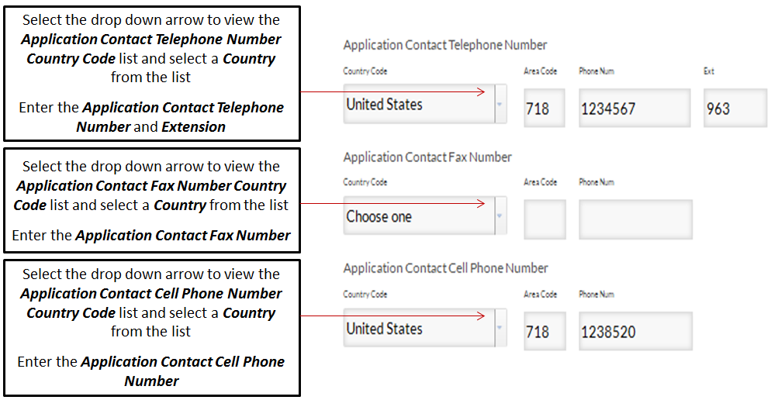
Application Contact (Cont.)
Enter the Application Contact’s Phone information
Notes:
Enter the Application Contact’s Phone Number information
Select the drop down arrow to view a list of Application Contact Telephone Number Country Codes. Select a Country Code from the list.
Enter the Application Contact Telephone Number and if applicable, the Extension. Enter N/A if there is no Extension.
Select the drop down arrow to view a list of Application Contact Fax Number Country Codes. Select a Country Code from the list.
Enter the Application Contact Fax Number.
Select the drop down arrow to view a list of Application Contact Cell Phone Number Country Codes. Select a Country Code from the list.
Enter the Application Contact Cell Phone Number.

Slide 26
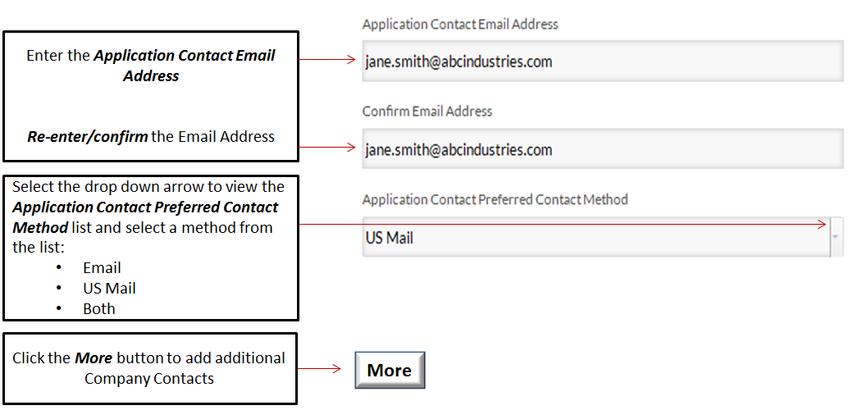
Application Contact (Cont.)
Enter the Application Contact’s Email and Contact Method information
Notes:
Enter the Application Contact’s Email Address and Contact Method.
Enter the Application Contact Email Address. Re-enter or confirm the Application Contact Email Address.
Select the drop down arrow to view a list of the Application Contact Preferred Contact Methods. Select an Application Contact Preferred Contact Method from the list.
Options include:
Email
US Mail
Both
If the there’s no information to enter for a field, don’t leave it blank enter N/A.
Click the More button to add additional Application Contacts.
Click Next in the Navigation Menu to move to the next page.

Slide 27
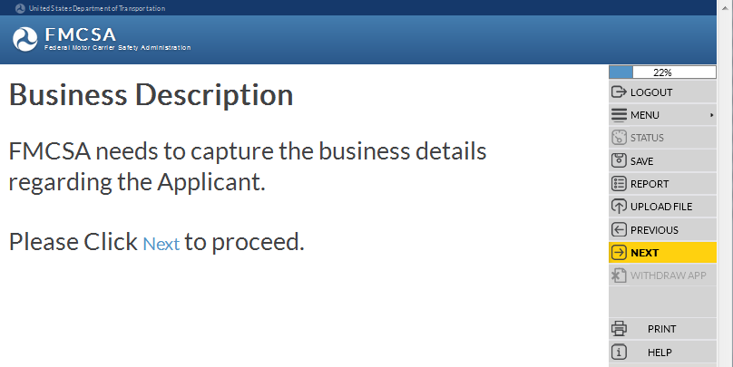
Business Description
FMCSA needs to capture the business details regarding the Applicant:
Dunn & Bradstreet Number
Legal and Doing Business As Name
Principal Place of Business Addresses
Telephone, Fax, Cell Numbers
EIN or SSN
If applicable, Canadian NCS Number
If applicable, Mexico RFC Number
Unit of Government
Form of Business
Ownership and Control
Company Contact Names, Titles and Addresses
Notes:
Business Description.
FMCSA needs to capture the business details regarding the Applicant applying for new registration.
The information includes the following:
Dunn & Bradstreet Number
Legal and Doing Business As Name
Principal Place of Business Addresses
Telephone, Fax, Cell Numbers
EIN or SSN
If applicable, Canadian NCS Number
If applicable, Mexico RFC Number
Unit of Government
Form of Business
Ownership and Control
Company Contact Names, Titles and Addresses
Click Next in the Navigation Menu to move to the next page.

Slide 28
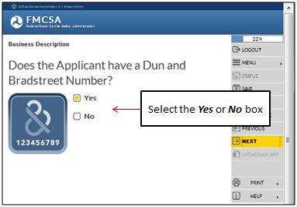
Business Description (Cont.)
Does the Applicant have a Dun and Bradstreet Number?
If yes, please enter the Dun and Bradstreet Number
Notes:
Does the Applicant have a Dun and Bradstreet Number?
If the Applicant has a Dun and Bradstreet Number, select the Yes box.
If the Applicant does NOT have a Dun and Bradstreet Number, select the No box.
Click Next in the Navigation Menu to move to the next page.
If yes, please enter the Dun and Bradstreet Number.
Click Next in the Navigation Menu to move to the next page.

Slide 29
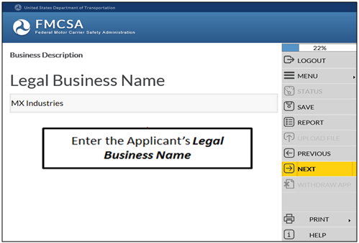
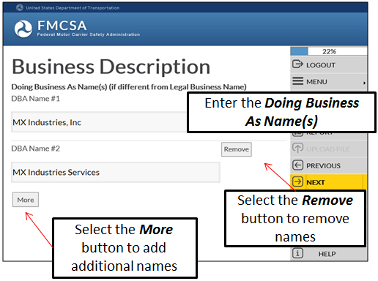
Business Description (Cont.)
Enter the Applicant’s Doing Business As Name
(if different from Legal Business Name)
Enter the Applicant’s Legal Business Name
Notes:
Enter the Applicant’s Legal Business Name.
Click Next in the Navigation Menu to move to the next page.
Enter the Applicant’s Doing Business As Name (if different from Legal Business Name).
Select the More button to add additional names.
Select the Remove button to remove names.
Click Next in the Navigation Menu to move to the next page.

Slide 30
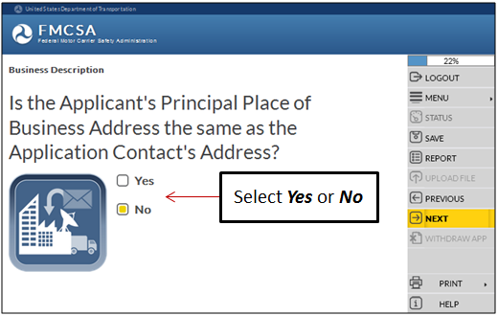
Business Description (Cont.)
Is the Applicant’s Principal Place of Business Address the same as the Application Contact’s Address?
If the Applicant’s Principal Place of Business Address is the same as the Application Contact’s Address, select Yes
If the Applicant’s Principal Place of Business Address is NOT the same as the Application Contact’s Address, select No
Notes:
Is the Applicant’s Principal Place of Business Address is the same as the Application Contact’s Address?
If the Applicant’s Principal Place of Business Address is the same as the Application Contact’s Address, select the Yes box.
If the Applicant’s Principal Place of Business Address is NOT the same as the Application Contact’s Address, select the No box.
Click Next in the Navigation Menu to move to the next page.

Slide 31
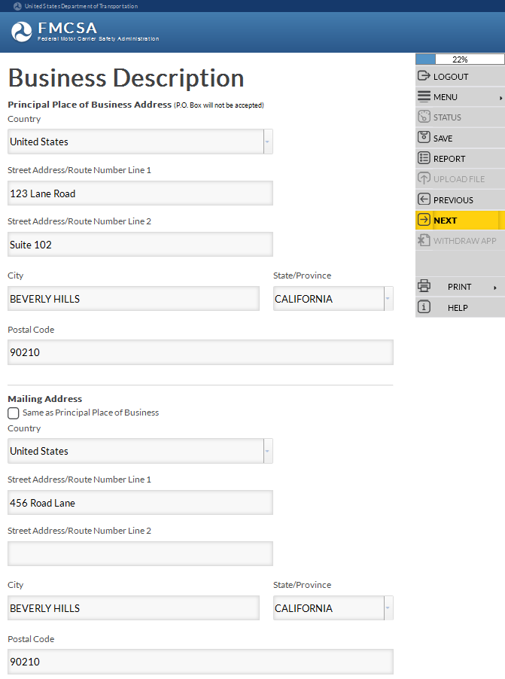
Business Description (Cont.)
P.O. Box is NOT accepted for Principal Place of Business Address
Is the Mailing Address the same as the Principal Place of Business Address?
If Yes, select the check box and the address will populate
If No, enter the Mailing Address information
Mailing Address is the same as the Principal Place of Business, select the check box the address will populate
Mailing Address is NOT the same as Principal Place of Business, enter the Mailing Address information
Notes:
Is the Mailing Address the same as the Principal Place of Business Address?
If Yes, select the check box and the address will populate
If No, enter the Mailing Address information
P.O. Box is not accepted as a Principal Place of Business Address.
Click Next in the Navigation Menu to move to the next page.

Slide 32
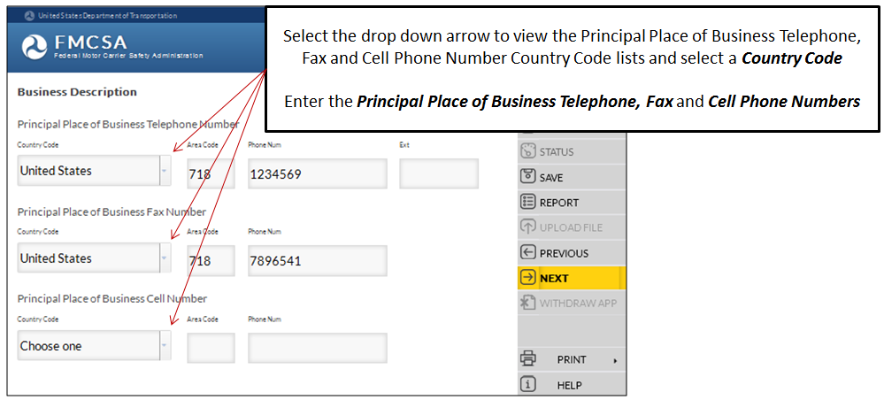
Business Description (Cont.)
Enter the Principal Place of Business Phones information
Notes:
Enter the Principal Place of Business Telephone Number information.
Select the drop down arrow to view a list of Principal Place of Business Telephone Number Country Codes. Select a Country Code from the list.
Enter the Principal Place of Business Telephone Number and if applicable, the Extension.
Select the drop down arrow to view a list of Principal Place of Business Fax Number Country Codes. Select a Country Code from the list.
Enter the Principal Place of Business Fax Number.
Select the drop down arrow to view a list of Principal Place of Business Cell Phone Number Country Codes. Select a Country Code from the list.
Enter the Principal Place of Business Cell Phone Number.
Click Next in the Navigation Menu to move to the next page.

Slide 33
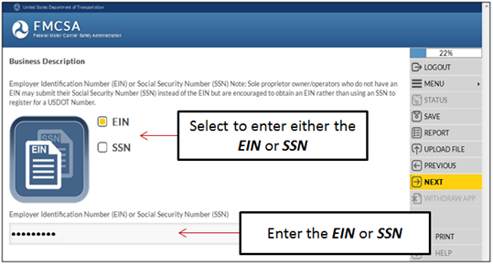
Business Description (Cont.)
Provide the Employer Identification Number (EIN) or the Social Security Number (SSN)
Note: Sole proprietor owner/operators who do not have an EIN are encouraged to obtain an EIN rather than using an SSN to register for a USDOT Number.
Notes:
Employer Identification Number (EIN) or Social Security Number (SSN). Sole proprietor owner/operator who do not have an EIN may submit their SSN instead of the EIN but are encouraged to obtain an EIN rather than using a SSN to register for a USDOT Number.
Select the box to enter either the EIN or SSN.
Enter the EIN or SSN in the field.
Click Next in the Navigation Menu to move to the next page.

Slide 34
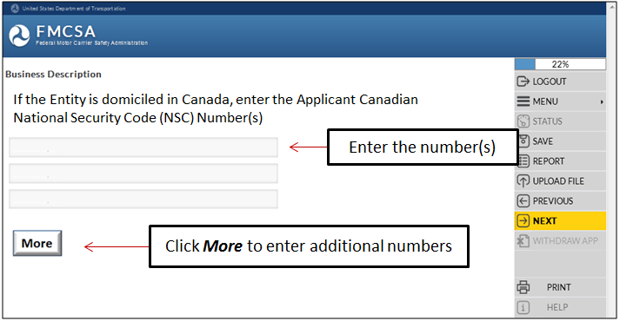
Business Description (Cont.)
If the Applicant is domiciled in Canada, the following will display:
Enter the Applicant Canadian National Security Code (NSC) Number(s)
Will display ONLY if the Applicant is domiciled in Canada
Notes:
If the Applicant is domiciled in Canada, the following will display: Enter the Applicant Canadian National Security Code (NSC) Number(s).
Click More to enter additional numbers.
Click Next in the Navigation Menu to move to the next page.

Slide 35
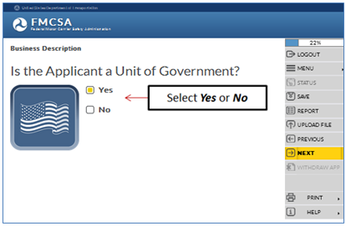
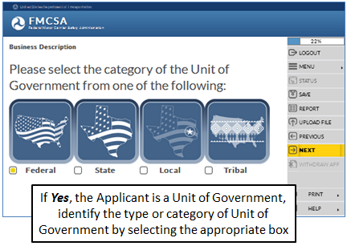
Business Description (Cont.)
Is the Applicant a Unit of Government?
Please select the category of the Unit of Government
Notes:
Is the Applicant a Unit of Government?
If the Applicant is a Unit of Government, select the Yes box.
If the Applicant is NOT a Unit of Government, select the No box.
Click Next in the Navigation Menu to move to the next page.
Please select the category of the Unit of Government from one of the following:
Federal
State
Local
Tribal
Click Next in the Navigation Menu to move to the next page.

Slide 36
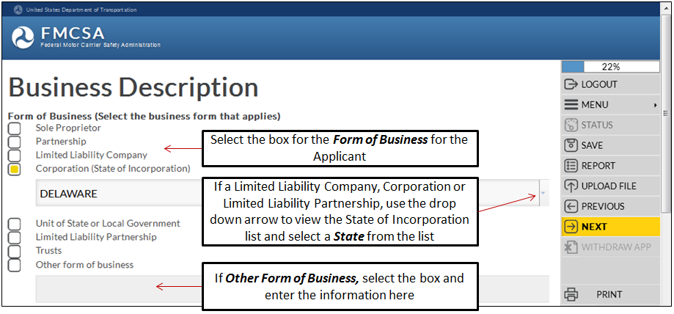
Business Description (Cont.)
Select the Form of Business for the Applicant
Notes:
Select the box to identify the Form of Business for the Applicant.
If the Applicant is a Limited Liability Company, Corporation or Limited Liability Partnership, use the drop down arrow to view the State of Incorporation list and select a State from the list.
If Other Form of Business, select the box and enter the form of business information for the Applicant.
Click Next in the Navigation Menu to move to the next page.

Slide 37
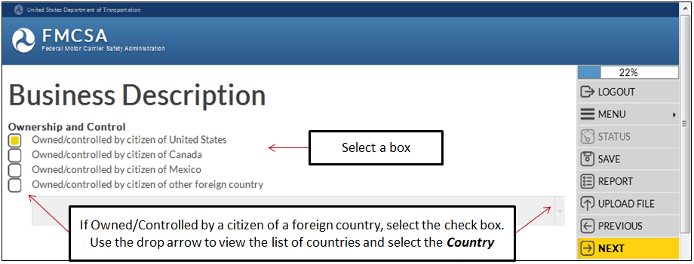
Business Description (Cont.)
Identify if the Applicant is Owned/Controlled by a citizen of the United States or another country
Notes:
Identify if the Applicant is Owned/Controlled by a citizen of the United States or another country.
Select the applicable Owned/Controlled box for the Applicant.
If the Applicant is owned/controlled by a citizen of a foreign country, use the drop down arrow to view the list of countries and select a Country from the list.
Click Next in the Navigation Menu to move to the next page.

Slide 38
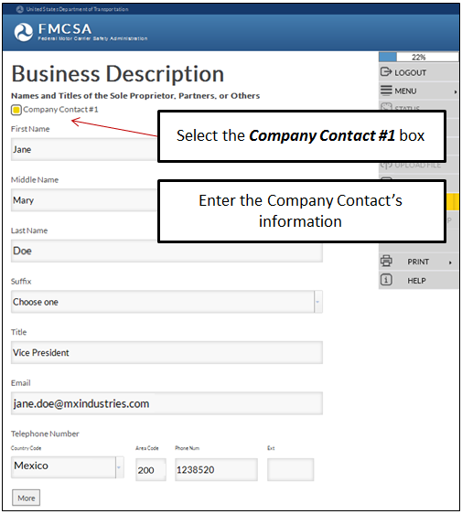
Business Description (Cont.)
FMCSA needs to capture contact information for the Sole Proprietors, Partners or Others
First Name
Middle Name
Last Name
Suffix
Title
Email Address
Telephone Number
Select More to enter additional contacts
Notes:
FMCSA needs to capture contact information for the Sole Proprietors, Partners or Others.
Select the Company Contact #1 box
Enter the Company Contact persons information:
First Name
Middle Name
Last Name
Suffix, values include: Jr., Sr., 2nd , 3rd , II, III, IV, V, VI
Select the drop down arrow to view a list of Suffixes and select a Suffix from the list.
Title
Email Address
Telephone Number
To add additional Company Contacts, select the More button.
Click Next in the Navigation Menu to move to the next page.

Slide 39
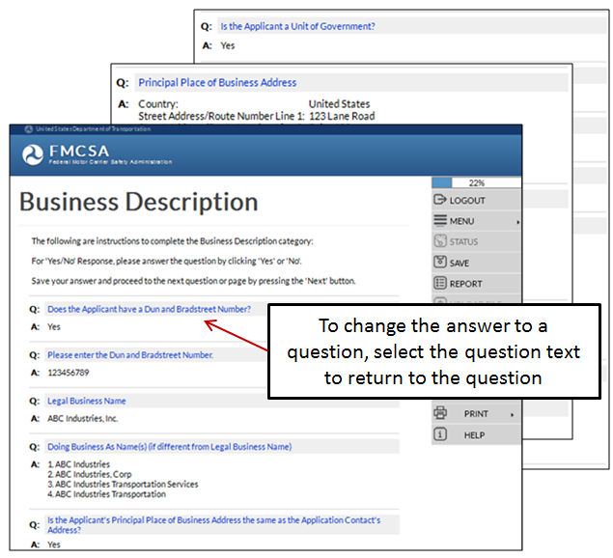
Business Description (Cont.)
Review the Business Description Summary for accuracy
To change an answer to a question, click the question text to return to the question to change the answer
Notes:
Business Description Summary.
Review the Business Description Summary for accuracy.
To change an answer to a question, click the question text to return to the question to change the answer.
Click Next in the Navigation Menu to move to the next page.

Slide 40
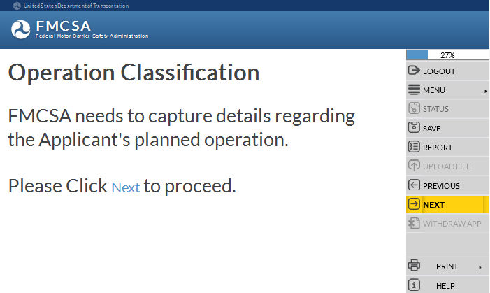
Operation Classification
Some of the questions in the following section may or may not display in the URS Online Application Process.
The questions display based on the answers selected or entered by the Applicant.
FMCSA needs to capture details regarding the Applicant’s planned operation:
Intermodal Equipment Provider
Transporting Property
Broker Services (Property, HHG)
Type of Cargo or Property Transporting
Transporting passengers
Freight Forwarder Services
Cargo Tank Facility
Driveaway or Towaway
Classification of Cargo
Note: Reference the Entity specific training module for details on Operation Classification
Notes:
Operation Classification. FMCSA needs to capture details regarding the Applicant’s planned operation. This includes the following information: Intermodal Equipment Provider Transporting Property Broker Services Type of Cargo or Property Transporting Transporting across state lines with/without HM Transporting passengers Receiving a grant from the FTA Freight Forwarder Services Cargo Tank Facility Driveaway or Towaway Classification of Cargo Note: Reference the Entity specific training module for details on Operation Classification Click Next in the Navigation Menu to move to the next page.

Slide 41
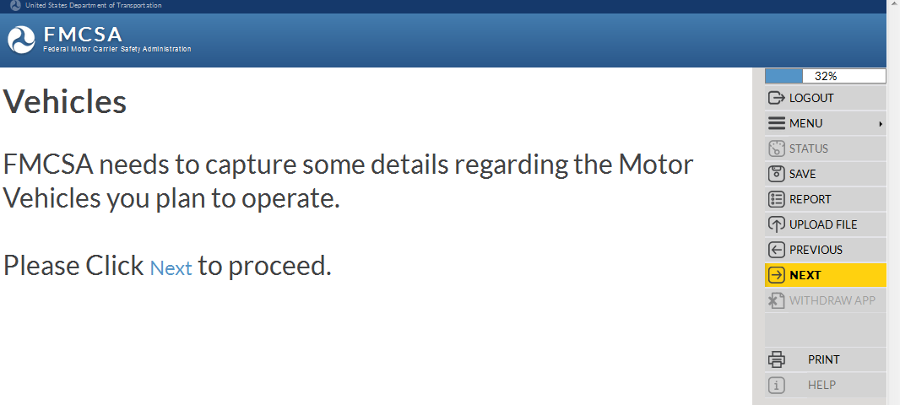
Vehicles
FMCSA needs to capture details regarding the Motor Vehicles being planned to operate:
Number of non-CMVs
Type of CMVs
Number of CMVs that will operate in Canada or Mexico
Number of CMVs that will operate in Interstate commerce
Number of CMVs that will operate in Intrastate commerce
Note: Reference the Entity specific training module for details on Vehicles
Notes:
Vehicles.
FMCSA needs to capture details regarding the Motor Vehicles being planned to operate.
This includes the following information:
Number of non-CMVs
Type of CMVs
Number of CMVs that will operate in Canada or Mexico
Number of CMVs that will operate in Interstate commerce
Number of CMVs that will operate in Intrastate commerce
Note: Reference the Entity specific training module for details on Vehicles
Click Next in the Navigation Menu to move to the next page.

Slide 42
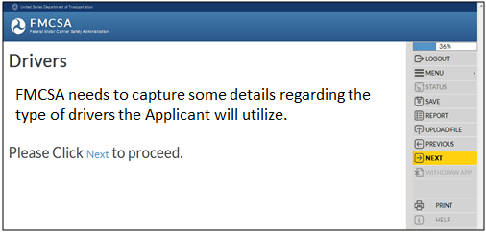
Drivers
FMCSA needs to capture details regarding the type of drivers the Applicant will utilize:
Number of drivers operating as Interstate
Number of drivers operating solely as Intrastate
Number of drivers operating in Canada or Mexico
Number of drivers with a CDL, Licencia Federal de Conductor (LFC), or a valid Canadian License Class 1, 2, 3, or 4 (or Class A, B, C, or D if licensed in Ontario)
Note: Reference the Entity specific training module for details on Drivers
Notes:
Drivers.
FMCSA needs to capture details about the drivers the Applicant will be using in its operations.
This includes the following information:
Number of drivers operating as Interstate
Number of drivers operating solely as Intrastate
Number of drivers with a CDL, Licencia Federal de Conductor (LFC), or a valid Canadian License Class 1, 2, 3, or 4 (or Class A, B, C, or D if licensed in Ontario)
Number of drivers operating in Canada or Mexico
Note: Reference the Entity specific training module for details on Drivers
Click Next in the Navigation Menu to move to the next page.

Slide 43
Hazardous Materials
FMCSA needs to capture some details regarding the type of Hazardous Materials (HM) Applicant will transport or ship:
Type of HM the Applicant transports and/or ships
Need a Hazardous Materials Safety Permit (HMSP)
Number of accidents, as defined in 49 CFR 390.5
Satisfactory security program
Complete a Certification
Note: Reference the Entity specific training module for details on Hazardous Materials
Notes:
Hazardous Materials.
FMCSA needs to capture some details regarding the type of Hazardous Materials (HM) Applicant will transport or ship:
Type of HM the Applicant transports and/or ships
Need a Hazardous Materials Safety Permit (HMSP)
Number of accidents, as defined in 49 CFR 390.5 the Applicant had in the past 12 months
Satisfactory security program in place as required in 49 CFR Part 385, Subpart E
Required by any state(s) to have a permit for any of the Hazardous Materials
Complete a Certification
Note: Reference the Entity specific training module for details on Hazardous Materials
Click Next in the Navigation Menu to move to the next page.

Slide 44
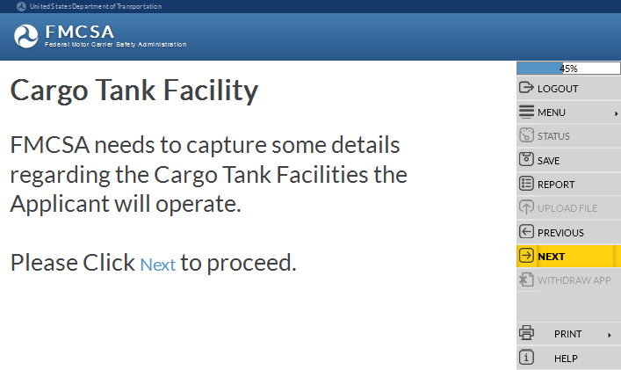
Cargo Tank Facility
FMCSA needs to capture some details regarding the Cargo Tank Facilities the Applicant will operate:
How many and the Names
Addresses
Functions, Exemptions, Special Permits, Vehicles
Manufacture or Repair functions
Uses mobile testing/inspection equipment
Contact, Inspector information
American Society of Mechanical Engineers (ASME) Certificate of Authorization
Certification
Note: Reference the Entity specific training module for details on Cargo Tank Facility
Notes:
Cargo Tank Facility.
The information being collected in this section is needed for each Cargo Tank Facility being registered.
FMCSA needs to capture some details regarding the Cargo Tank Facilities the Applicant will operate:
How many and the Names
Addresses
Functions, Exemptions, Special Permits, Vehicles
Manufacture or Repair functions
Uses mobile testing/inspection equipment
Contact, Inspector information
American Society of Mechanical Engineers (ASME) Certificate of Authorization
Certification
Note: Reference the Entity specific training module for details on Cargo Tank Facility
Click Next in the Navigation Menu to move to the next page.

Slide 45
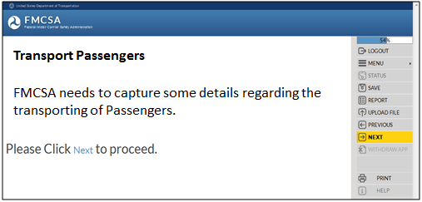
Transport Passengers
FMCSA needs to capture some details regarding the transporting of Passengers:
Receive any federal transportation grant funds
Public recipient or private recipient of governmental financial assistance
Submit evidence as requested
Complete a Certification
Note: Reference the Entity specific training module for details on Transportation of Passengers
Notes:
Transport Passengers.
FMCSA needs to capture some details regarding the transporting of Passengers:
Applicant receive any federal transportation grant funds that will subsidize their transportation provided under this registration
Applicant a public recipient or private recipient of governmental financial assistance
Applicants for charter or special transportation must submit evidence to demonstrate it
Applicants requesting authority to operate over regular routes upload to the application a description of the specific routes over which you intend to provide regularly scheduled service
Complete a certification
Note: Reference the Entity specific training module for details on Transport Passengers
Click Next in the Navigation Menu to move to the next page.

Slide 46
Household Goods
FMCSA would like to capture the details for the Arbitration Program and Tariff for the Applicant regarding the transportation of Household Goods (HHG):
HHG Certification
Arbitration Program Name, Address and Telephone Number
Provide evidence of participation in an Arbitration Program
HHG Brokerage Certification
Note: Reference the Entity specific training module for details on Household Goods
Notes:
Household Goods.
FMCSA would like to capture the details for the Arbitration Program and Tariff for the Applicant regarding the transportation of Household Goods (HHG):
HHG Certification
Arbitration Program Name, Address and Telephone Number
Provide evidence of participation in an Arbitration Program
HHG Brokerage Certification
Note: Reference the Entity specific training module for details on Household Goods
Click Next in the Navigation Menu to move to the next page.

Slide 47
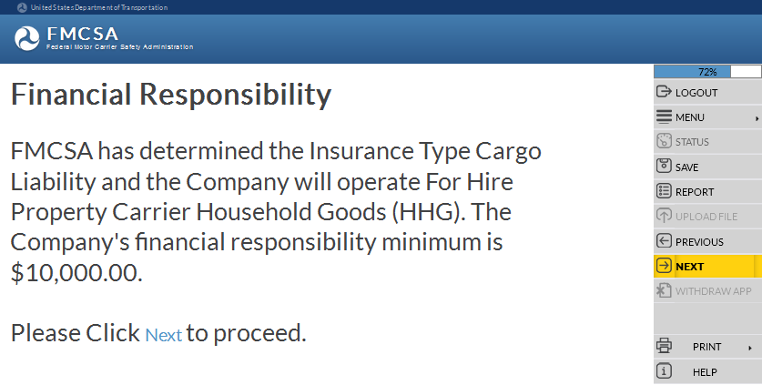
Financial Responsibility
Based on the Operation Classification information provided in the application, FMCSA will determine the Entity’s financial responsibility minimum for insurance amounts
Insurance Type Cargo Liability
Insurance Type Surety Bond or Trust Fund
The Applicant must ensure the evidence of financial responsibility is filed with FMCSA before new registration can be granted
Notes:
Financial Responsibility.
Based on the Operation Classification information provided in the application, FMCSA will determine the financial responsibility minimum for insurance amounts:
Insurance Type Cargo Liability
Insurance Type Surety Bond or Trust Fund
The Applicant must ensure the evidence of financial responsibility is filed with FMCSA before new registration can be granted.
Click Next in the Menu to move to the next page.

Slide 48
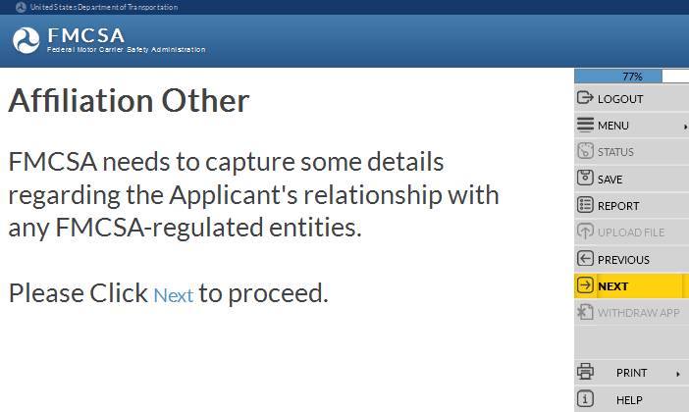
Affiliation with Others
FMCSA needs to capture details regarding the Applicant’s relationship with any FMCSA-regulated entities:
If the Applicant has had within the last 3 years of the date of filing this application relationships involving common stock, ownership, management, control or familial relationships or any other person(s) or applicant for registration provide the Entity’s USDOT Number
Notes:
Affiliation with Others.
FMCSA needs to capture some details regarding the Applicant's relationship with any FMCSA-regulated entities.
If the Applicant has had within the last 3 years of the date of filing this application relationships involving common stock, ownership, management, control or familial relationships or any other person(s) or applicant for registration provide the Entity’s USDOT Number.
Click Next in the Navigation Menu to move to the next page.

Slide 49
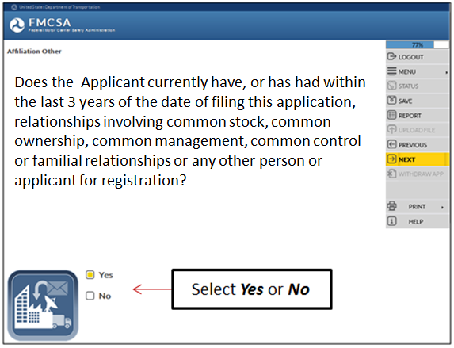
Affiliation with Others (Cont.)
If the Applicant has had relationships in the past three years with another Applicant for registration, select Yes
If the Applicant has NOT had relationships in the past three years with another Applicant for registration, select No
Notes:
Does the Applicant currently have, or has had within the last 3 years of the date of filing this application, relationships involving common stock, common ownership, common management, common control or familial relationships or any other person or applicant for registration?
If the Applicant has or has had within the last 3 years of the date of filing this application, relationships with an applicant for registration, select the Yes box.
If the Applicant has NOT had within the last 3 years of the date of filing this application, relationships with an applicant for registration, select the No box.
Click Next in the Navigation Menu to move to the next page.

Slide 50
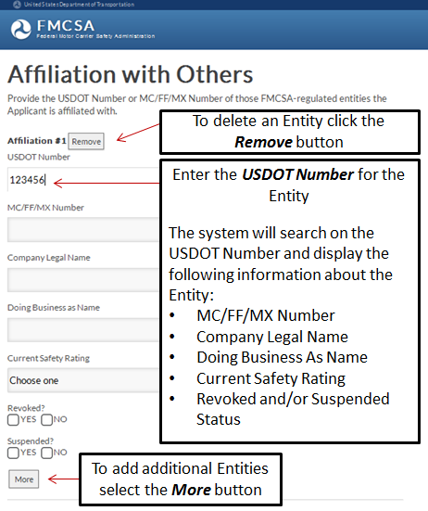
Affiliation with Others (Cont.)
If the Applicant does have relationships with another person and/or Applicant for registration, enter the Entity’s USDOT Number
The system will search the USDOT Number and display details about the Entity
Notes:
If the Applicant does have or had relationships with another Entity in the past three years, enter the Entity’s USDOT Number.
The system will search on the USDOT Number and display the following information for the USDOT Number entered:
MC/FF/MX Number
Company Legal Name
Doing Business as Name
Current Safety Rating
Revoked Status
Suspended Status
To enter additional USDOT Numbers click the More button.
To delete USDOT Numbers entered click the Remove button.
Click Next in the Navigation Menu to move to the next page.

Slide 51
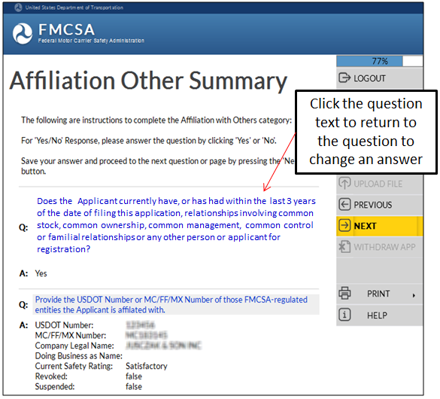
Affiliation with Other (Cont.)
Review the Affiliation Summary for accuracy
To change an answer to a question, click the question text to return to the question to change the answer
Notes:
Review the Affiliation with Others Summary of questions and answers to ensure the information is correct.
To edit the answers, click the corresponding question.
Click Next in the Navigation Menu to move to the next page.

Slide 52
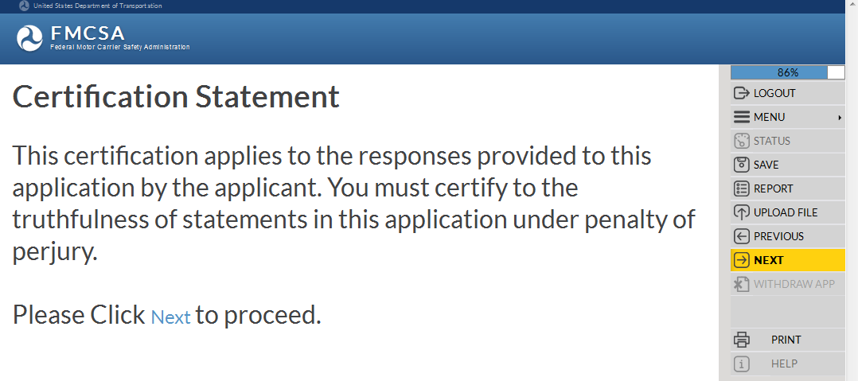
Certification Statement
This certification applies to the responses provided to this application by the Applicant
The Applicant must certify to the truthfulness of statements in this application under penalty of perjury
Notes:
Certification Statement.
This certification applies to the responses provided to this application by the Applicant.
The Applicant must certify to the truthfulness of statements in this application under penalty of perjury.
Click Next in the Navigation Menu to move to the next page.

Slide 53
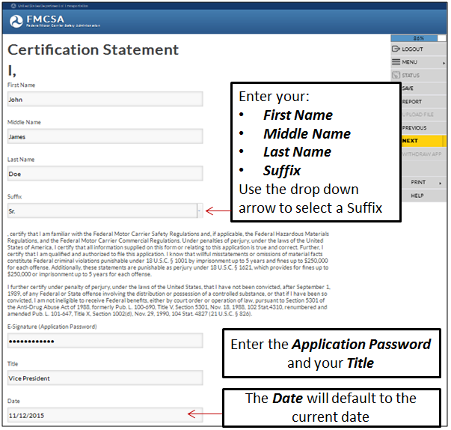
Certification Statement (Cont.)
Enter the following information:
First Name
Middle Name
Last Name
Suffix
Title
E-signature (Application Password)
Date (will display the current date)
Notes:
Enter your First, Middle, Last Name and Suffix (Suffix values: Jr., Sr., 2nd , 3rd , II, III, IV, V, VI)
Read the certification: I certify that I am familiar with the Federal Motor Carrier Safety Regulations and, if applicable, the Federal Hazardous Materials Regulations, and the Federal Motor Carrier Commercial Regulations. Under penalties of perjury, under the laws of the United States of America, I certify that all information supplied on this form or relating to this application is true and correct. Further, I certify that I am qualified and authorized to file this application. I know that willful misstatements or omissions of material facts constitute Federal criminal violations punishable under 18 U.S.C. § 1001 by imprisonment up to 5 years and fines up to $250,000 for each offense. Additionally, these statements are punishable as perjury under 18 U.S.C. § 1621, which provides for fines up to $250,000 or imprisonment up to 5 years for each offense.
I further certify under penalty of perjury, under the laws of the United States, that I have not been convicted, after September 1, 1989, of any Federal or State offense involving the distribution or possession of a controlled substance, or that if I have been so convicted, I am not ineligible to receive Federal benefits, either by court order or operation of law, pursuant to Section 5301 of the Anti-Drug Abuse Act of 1988, formerly Pub. L. 100-690, Title V, Section 5301, Nov. 18, 1988, 102 Stat.4310, renumbered and amended Pub. L. 101-647, Title X, Section 1002(d), Nov. 29, 1990, 104 Stat. 4827 (21 U.S.C. § 826).
Enter your Application Password and Title.
The Date will default to the current date.
Click Next in the Navigation Menu to move to the next page.

Slide 54
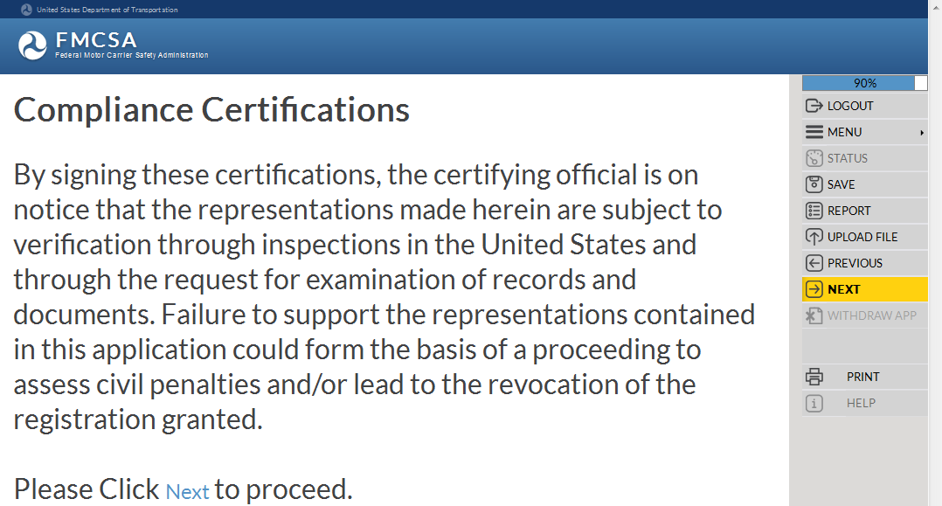
Compliance Certifications
Signing the certifications, the Certifying Official is on notice the representations made are subject to verification through inspections in the U.S. and through the request for examination of records and document
Failure to support the representations in this application could form the basis of a proceeding to assess civil penalties and/or lead to the revocation of the registration granted
Notes:
Compliance Certifications.
By selecting “Yes” to Certify to the certifications, the certifying official is on notice that the representations made herein are subject to verification through inspections in the United States and through the request for examination of records and documents.
Failure to support the representations contained in this application could form the basis of a proceeding to assess civil penalties and/or lead to the revocation of the registration granted.
Click Next in the Navigation Menu to move to the next page.

Slide 55
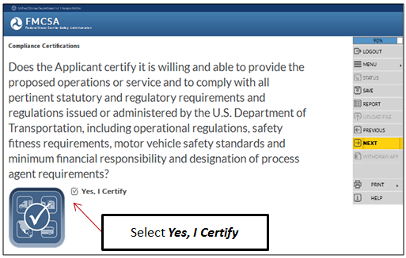
Compliance Certifications (Cont.)
Provide operations and comply with statutory and regulatory requirements and regulations
Produce documents for review or inspection upon request
Notes:
Does the Applicant certify it is willing and able to provide the proposed operations or service and to comply with all pertinent statutory and regulatory requirements and regulations issued or administered by the U.S. Department of Transportation, including operational regulations, safety fitness requirements, motor vehicle safety standards and minimum financial responsibility and designation of process agent requirements? Select the Yes, I Certify check box. Click Next in the Navigation Menu to move to the next page. Does the Applicant certify it is willing and able to produce for review or inspection documents which are requested for the purpose of determining compliance with applicable statutes and regulations administered by the Department of Transportation, including the Federal Motor Carrier Safety Regulations, Federal Motor Vehicle Safety Standards, Commercial Regulations, Hazardous Materials Regulations, and Americans With Disabilities Act regulations within 48 hours of any written request? Applicant understands that the written request for documents may be served on the contact person identified in the company contact section of this application, or the designated process agent? Select the Yes, I Certify check box. Click Next in the Navigation Menu to move to the next page.

Slide 56
Compliance Certifications (Cont.)
Entity NOT disqualified from operating CMV in the U.S.
Process Agent Designation
Notes:
Does the Applicant certify it is not currently disqualified from operating commercial motor vehicles in the United States? Select the Yes, I Certify check box. Click Next in the Navigation Menu to move to the next page. Does the Applicant certify it understands that the agent(s) for service of process designation will be deemed the applicant’s official representative(s) in the United States for receipt of filings and notices in administrative proceedings under 49 U.S.C. § 13303, and for receipt of filings and notices issued in connection with the enforcement of any Federal statutes or regulations? Select the Yes, I Certify check box. Click Next in the Navigation Menu to move to the next page.

Slide 57
Compliance Certifications (Cont.)
Entity NOT prohibited from filing for registration
Corrected registration revocation deficiencies
Notes:
Does the Applicant certify that the carrier is not prohibited from filing this application because its FMCSA registration is currently under suspension, or was revoked less than 30 days before filing the application?
Select the Yes, I Certify check box.
Click Next in the Navigation Menu to move to the next page.
If the Applicant's registration is currently revoked, does the Applicant certify the deficiencies cited in the revocation proceeding have been corrected?
Select the Yes, I Certify check box.
Click Next in the Navigation Menu to move to the next page.

Slide 58
Compliance Certifications (Cont.)
Corrected registration revocation deficiencies
Notes:
If the Applicant's registration is currently revoked, does the Applicant certify the deficiencies cited in the revocation proceeding have been corrected?
Select the Yes, I Certify check box.
Click Next in the Navigation Menu to move to the next page.

Slide 59
Compliance Certifications (Cont.)
Notes:
Enter the Application Password for the Electronic Signature.
Click Next in the Navigation Menu to move to the next page.
Review the Compliance Certifications Summary of questions and answers for accuracy.
To change an answer, click the question text.
Click Next in the Navigation Menu to move to the next page.

Slide 60
Applicant’s Oath
FMCSA requires the Owner or the Authorized Signer or an individual with power of attorney to act on behalf of the Applicant to sign the Applicant’s Oath certifying all information supplied in this application or relating to this application is true and correct
Notes:
Applicant’s Oath.
FMCSA requires the owner or the authorized signer or an individual with power of attorney to act on behalf of the applicant (proof of the power of attorney must be uploaded and submitted with the application) to sign the Applicant's Oath certifying that all information supplied in this application or relating to this application is true and correct.
Enter the information and click Next in the Navigation Menu to move to the next page.

Slide 61
Applicant’s Oath (Cont.)
Oath applies to all supplemental filings to this application
Signature must be that of an Authorized Official of the Applicant, not the Legal Representative
Notes:
This oath applies to all supplemental filings to this application. The signature must be that of an authorized official of the applicant, not the legal representative.
Enter your First, Middle, Last Name and Suffix (Suffix values: Jr., Sr., 2nd , 3rd , II, III, IV, V, VI)
I, First Name, Last Name and Title, verify under penalty of perjury, under the laws of the United States of America, that all information supplied on this form or relating to this application is true and correct. Further, I certify that I am qualified and authorized to file this application. I know that willful misstatements or omissions of material facts constitute Federal criminal violations punishable under 18 U.S.C. § 1001 by imprisonment of up to 5 years and fines up to $250,000 for each offense. Additionally these statements are punishable as perjury under 18 U.S.C. § 1621, which provides for fines of up to $250,000 or imprisonment of up to 5 years for each offense.
I further certify under penalty of perjury, under the laws of the United States, that I have not been convicted, after September 1, 1989, of any Federal or State offense involving the distribution of possession of a controlled substance, or that if I have been so convicted, I am not ineligible to receive Federal benefits, either by court order or operation of law, pursuant to Section 5301 of the Anti-Drug Abuse Act of 1988, formerly Pub. L. 100-690, Title V, Section 5301, Nov. 18, 1988, 102 Stat. 4310, renumbered and amended Pub. L. 101-647, Title X, Section 1002 (d), Nov. 29, 1990, 104 Stat. 4827 (21 U.S.C. 862).
Enter your Application Password and Title.
The Date will default to the current date.
Click Next in the Navigation Menu to move to the next page.

Slide 62
URS Company Official Portal Account
Applicants are required to have FMCSA Portal access to maintain their registration information and to monitor their safety information and activity
An individual needs to be assigned the Company Official role for the FMCSA Portal
For detailed information on this application section, reference the training module: “URS Company Official Portal Account”
Notes:
URS Company Official Portal Account.
FMCSA requires applicants to have access to the FMCSA Portal to maintain their registration information and to monitor their safety information and activity.
As part of submitting the application for registration, an individual needs to be assigned the Company Official role for the FMCSA Portal.
The Company Official administers access to sensitive company information in the FMCSA Portal or Existing Systems for their specific entity.
For more detailed information about the FMCSA Portal Company Official Account section of the application, reference the training module: “URS Company Official Portal Account”.
Click Next in the Navigation Menu to move to the next page.

Slide 63
Creating a PDF File of the Application for Viewing, Printing and Saving
The system can generate the application in PDF format for easy viewing, printing and saving the application to your preferred location
Notes:
Creating a PDF File of the Application for Viewing, Printing and Saving.
The system can generate the application in PDF format for easy viewing, printing and saving the application to your preferred location.
Step 1: Select Report in the Navigation Menu
Step 2: When the window displays, select to Open or Save the PDF application.

Slide 64
Creating a PDF File of the Application for Viewing, Printing and Saving (Cont.)
If you selected to Open the application, it will display in PDF format
Notes:
If you selected to Open the application, it will display in PDF format.

Slide 65
Printing the Application
The application can be printed at any point in the application process
In the Navigation Menu select Print, select to print the current page or print the summaries of all the sections in your application
Notes:
Printing the Application.
The application can be printed at any point in the application process.
In the Navigation Menu select Print to print the current page or print the summaries of all the application sections.

Slide 66
Printing the Application (Cont.)
The option to Print ALL Summary – HTML, will open a new window displaying all the summaries for the completed sections in the application
Select Print Page to print all the summaries
Notes:
If selected to Print All Summary – HTML, a separate window will open displaying all the summaries for the completed sections in the application.
Only the summaries applicable to your application will be printed.
Select Print Page and all the section summaries in your application will be printed.

Slide 67
Payment Information
Operation Classification(s) determines the Applicant's required application fee dollar amount
The Applicant must ensure the evidence of process agent designation is filed with FMCSA before new registration can be granted
The Applicant must ensure the evidence of financial responsibility is filed with FMCSA before new registration can be granted
Notes:
Payment Information.
Based on the Operation Classification(s), FMCSA determines the Applicant's required application fee dollar amount.
The Applicant must ensure the evidence of process agent designation is filed with FMCSA before new registration can be granted.
The Applicant must ensure the evidence of financial responsibility is filed with FMCSA before new registration can be granted.
Click Next in the Navigation Menu to move to the next page.

Slide 68
Payment Information (Cont.)
Notes:
• FMCSA does not refund filing fees.
• Your filing fees must be payable to the Federal Motor Carrier Safety Administration, by Electronic Funding Transfer, or by an approved credit card.
• Electronic Funding Transfers must be from an account in a bank in the United States.
• Fees are required for each type of registration requested. For example, if applicant wishes to be registered as both a motor carrier and a broker, applicant may file a single application and make a single payment of $600.
• FTA grantees do not pay a fee to file an application for registration.
• FMCSA will not process an applicant’s application until the payment has been deducted from his/her banking or credit card account.
• Creation of a FMCSA application does not guarantee access to the FMCSA Portal Account.
Click Next in the Navigation Menu to move to the next page.

Slide 69
Payment Information – Electronic Funds Transfer (EFT)
The application fee dollar amount will display
Notes:
The application fee dollar amount will display.
Steps to pay by EFT:
Step 1: Select the EFT box
Step 2: Enter the Bank Name, Bank Routing Number and Checking Account Number
Step 3: Select the box to authorize FMCSA to charge the account
Step 4: Enter your First, MI, Last Name and Suffix
Step 5: Enter the Application Password to E-sign
Step 6: The Date the application was submitted will default to the current date
Step 7: Click Submit Payment

Slide 70
Payment Information – Credit Card
Notes:
Steps to Pay by Credit Card:
Step 1: Select the credit card you will use
Step 2: Enter the Credit Card Number, Expiration Month, Expiration Year and Security Code from the back of the card
Step 3: Enter your First, MI and Last Name
Step 4: Select the box to authorize the FMCSA to charge the account
Step 5: Enter the Application Password to E-sign
Step 6: The Date the application was submitted will default to the current date
Step 7: Click Submit Payment

Slide 71
Payment Information (Cont.)
A Thank You message will display acknowledging the payment was processed successfully and provides the next steps in the application process
Notes:
After the payment is processed a Thank You message will display acknowledging the payment was processed successfully and provides the next steps in the application process.
Thank you for submitting your application. Your payment of $300.00 has been processed.
Your entity has been assigned USDOT Number: 12345678
What's Next:
Your application is being reviewed for statutory and regulatory compliance.
You will receive a notification with your assigned USDOT Number and PIN Number.
If you applied for an Operating Authority Registration, you will receive a notification with your assigned Docket Number and PIN Number.
If you applied for an Operating Authority Registration, a table will display providing how your Operating Authority will be presented in the other FMCSA Systems.
Please print this page to keep for records.

Slide 72
Uploading Documents
Additional documents can be uploaded and submitted with the application.
Notes:
Additional documents can be uploaded and submitted with the application.
Step 1: In the Navigation Menu select Upload File.
Step 2: In the Application Documents Upload window, click Browse to find the file location and the file to upload.
Step 3: Select the file to upload.

Slide 73
Uploading Documents (Cont.)
Notes:
Step 4: In the Application Documents Upload window, select the drop down arrow to view the list of Document Types. Select the type of document you are uploading.
Step 5: Click Upload.

Slide 74
Returning to Complete an Incomplete Application
An Applicant may return to complete an incomplete application within 30 calendar days from the date it was saved
To complete an application select the Returning Applicant box under the blue avatar located in front of the equal symbol
Notes:
Returning to Complete an Incomplete Application. An Applicant may return to complete an incomplete application within 30 calendar days from the date it was saved. To complete an application select the Returning Applicant box under the blue avatar located in front of the equal symbol. Click Next in the Navigation Menu to move to the next page.

Slide 75
Returning to Complete an Incomplete Application (Cont.)
If you have forgotten the Applicant ID select the Click Here link to recover the Applicant ID
If you have forgotten the Password select the Click Here link to recover the Password
Notes:
Enter the Applicant ID and Password.
If you have forgotten the Applicant ID, select the Click Here link under the box and follow the instructions to recover the Applicant ID.
If you have forgotten the Password, select the Click Here link under the box and follow the instructions to recover the Password.
Click Next in the Navigation Menu to move to the next page.

Slide 76
End of the Training Module
End of the Training Module
Please Close the Browser Window
Notes:
This is the end of the training module, please close the browser window.

