Slide 1
Unified Registration System (URS)
Cargo Tank Facility U.S. and Canada: Submit an Application for New Registration
URS New Application Release for First-Time Applicants, January 2016, v1.1
Notes:
Unified Registration System (URS).
Cargo Tank Facility U.S. and Canada: Submit an Application for New Registration

Slide 2
Training Objectives
Prerequisite: Completion of the training module titled ‘Introduction to Submit an Application for New Registration’
Provide Cargo Tank Facilities an overview for submitting an application for New Registration using the URS Online Application Process
The functionality in this module includes the following:
Completing the Application for New Registration
Notes:
Training Objectives.
The prerequisite for this training module is the completion of the training module titled ‘Introduction to Submit an Application for New Registration’.
A training objective is to provide Cargo Tank Facilities an overview for submitting an application for New Registration using the URS Online Application Process.
The functionality in this module includes the following:
Completing the Application for New Registration

Slide 3
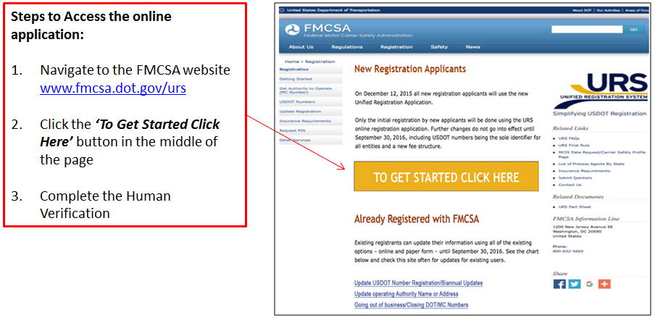
Accessing the URS Online Application Process
To apply for New Registration the URS Online Application Process can be accessed from the FMCSA Website, www.fmcsa.dot.gov/urs
Notes:
Accessing the URS Online Application Process.
To apply for New Registration the URS Online Application Process can be accessed from the FMCSA Website, www.fmcsa.dot.gov/urs.
These are the steps to access the online application:
Navigate to the FMCSA Website
Click the “To Get Started Click Here” button in the middle of the page
Completed the Human Verification

Slide 4
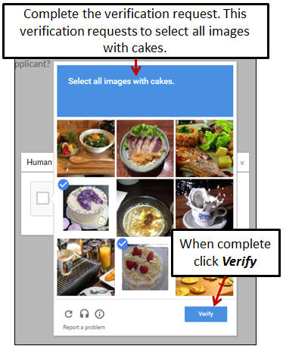
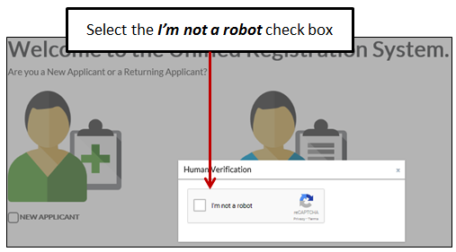
Accessing the URS Online Application Process (Cont.)
Before accessing the application the Applicant will need to provide Human Verification
Select the check box I’m not a robot
Complete the verification request
Notes:
Before accessing the application the Applicant will need to provide Human Verification.
Select the check box I’m not a robot
Complete the verification request
When complete, click Verify

Slide 5
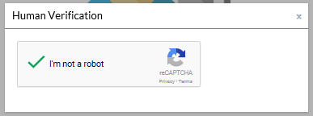
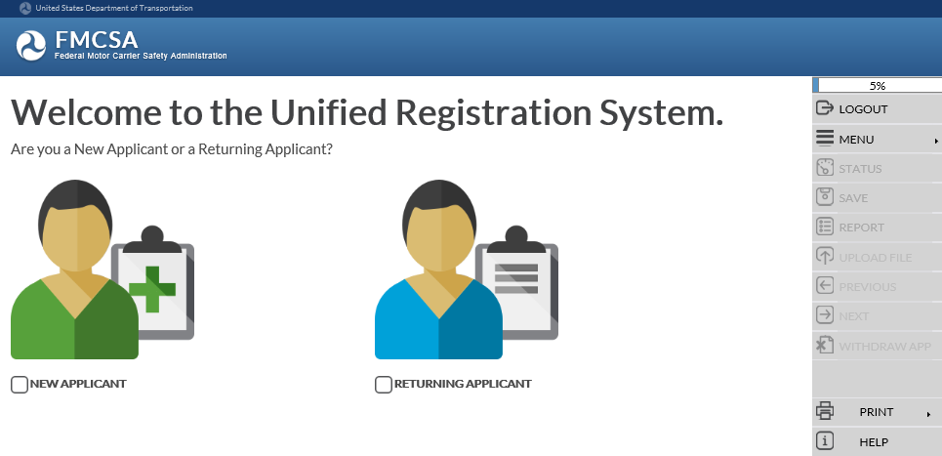
Accessing the URS Online Application Process (Cont.)
The system will display a green check mark confirming the human verification
The system will display the URS Welcome Page
Notes:
The system will display a green check mark confirming the human verification.
The system will display the URS Welcome page.

Slide 6
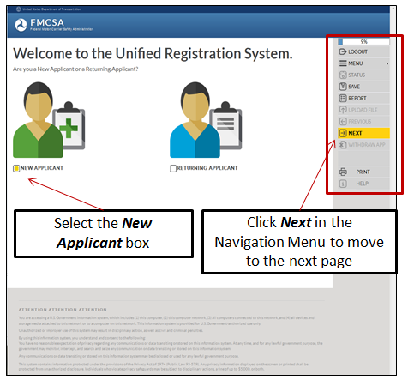
Welcome Page
Applicants applying for New Registration select the New Applicant box under the green avatar on the left side of the page
When all the information on a page has been provided, the Next button in the Navigation Menu on the right side of the page will display yellow
Click Next in the Navigation Menu to move to the next page
Notes:
Welcome Page.
The Welcome page provides the Applicant the option to choose New Applicant or Returning Applicant.
Applicants applying for New Registration select the New Applicant box under the green avatar on the left side of the page.
When all the information on a page has been provided, the Next option in the Navigation Menu on the right of the page will display yellow.
The Navigation Menu on the right side of the page will display throughout the URS Online Application Process.
Click Next in the Navigation Menu to move to the next page.

Slide 7
Detailed Information for the URS Online Application Process
Reference the training module ‘Introduction to Submit an Application for New Registration’ for detailed information on the following topics:
Navigating the URS Online Application Process
Required Information
Informational Notices
Application Contact Information
Business Description Information
Process Agent Designation
Financial Responsibility
Affiliation with Others
Certification Statement
Compliance Certifications
Applicant’s Oath
Submitting Payment
Uploading Documents
Returning to Complete an Incomplete Application
Notes:
Detailed Information for the URS Online Application Process.
Reference the training module ‘Introduction to Submit an Application for New Registration’ for detailed information on the following topics and application sections:
Navigating the URS Online Application Process
Required Information
Informational Notices
Application Contact Information
Business Description Information
Process Agent Designation
Financial Responsibility
Affiliation with Others
Certification Statement
Compliance Certifications
Applicant’s Oath
Submitting Payment
Uploading Documents
Returning to Complete an Incomplete Application

Slide 8
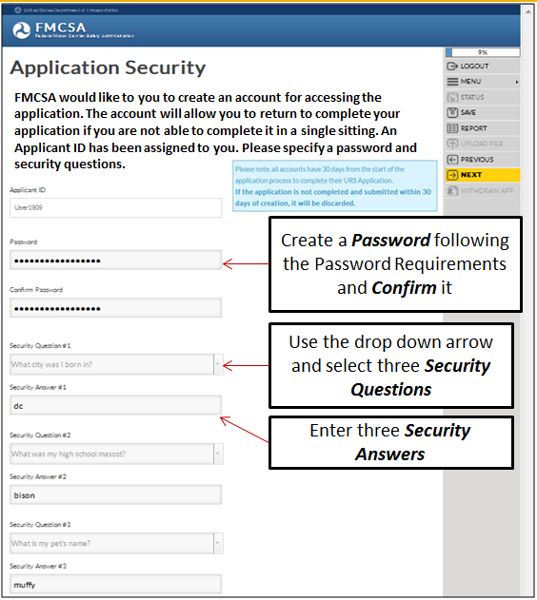
Application Security
FMCSA would like to you to create an account for accessing the application:
Applicant ID is system generated and assigned to the Applicant
Create a Password and Re-enter/Confirm Password, following the Password Requirements
Select three Security Questions and enter three Security Answers
Notes:
Application Security.
FMCSA would like to you to create an account for accessing the application. The account will allow you to return to complete your application if you are not able to complete it in a single sitting.
The Applicant ID is system generated and assigned to the Applicant and associated to the application being completed.
The Applicant will need to create a password, select three security questions and provide the answers.
A saved application must be completed within 30 calendar days of the saved date.
Enter a Password and Re-enter or Confirm the Password following the Password Requirements.
Use the Security Question drop down arrow to view the different questions. Select three Security Questions and provide the Security Answers in the blank fields.
The Application Security Page can be printed to retain the information for future use.
For more detailed information about the Application Security section of the application, reference the training module: “Introduction to Submit an Application for New Registration”.
Click Next in the Navigation Menu to move to the next page.

Slide 9
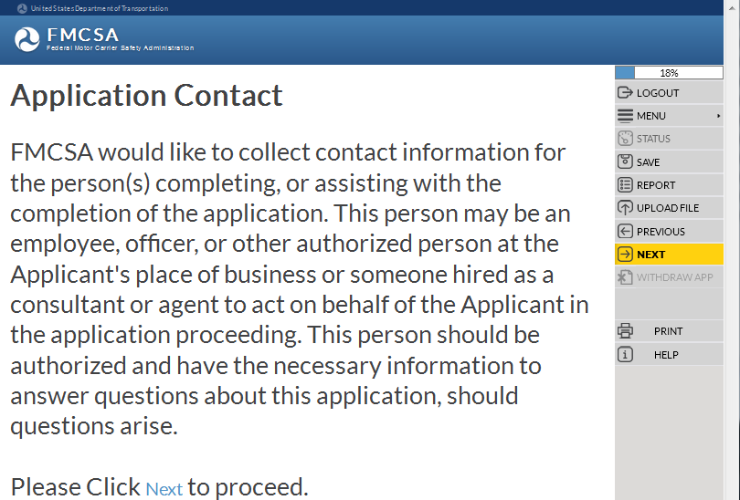
Application Contact
For detailed information on this application section, reference the training module: “Introduction to Submit an Application for New Registration”
FMCSA would like to collect contact information from the person(s) who is preparing or assisting with the completion of the application:
Application Contact Type
First, Middle, Last Name and Suffix
Title
Address
Email Address
Telephone, Fax and Cell Phone Numbers
Preferred Contact Method
Notes:
Application Contact.
FMCSA would like to collect contact information for the person(s) completing, or assisting with the completion of the application. This person may be an employee, officer, or other authorized person at the Applicant's place of business or someone hired as a consultant or agent to act on behalf of the Applicant in the application proceeding. This person should be authorized and have the necessary information to answer questions about this application, should questions arise.
The information includes the following:
Application Contact Type
First Name
Middle Name
Last Name
Suffix, values include: Jr., Sr., 2nd , 3rd , II, III, IV, V, VI
Title
Address
Email Address
Telephone, Fax and Cell Phone Numbers
Preferred Contact Method
For more detailed information about the Application Contact section of the application, reference the training module: “Introduction to Submit an Application for New Registration”.
Enter the information and click Next in the Navigation Menu to move to the next page.

Slide 10
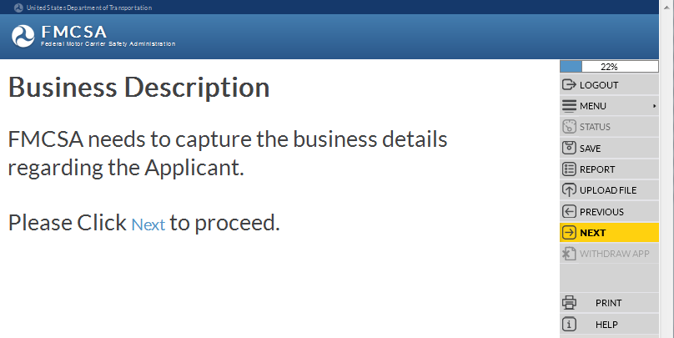
Business Description
FMCSA needs to capture the business details regarding the Applicant:
Dunn & Bradstreet Number
Legal and Doing Business As Name
Principal Place of Business Addresses
Telephone, Fax, Cell Numbers
EIN or SSN
If applicable, Canadian NCS Number
If applicable, Mexico RFC Number
Unit of Government
For detailed information on this application section, reference the training module: “Introduction to Submit an Application for New Registration”
Form of Business
Ownership and Control
Company Contact Names, Titles and Addresses
Notes:
Business Description.
FMCSA needs to capture the business details regarding the Applicant applying for new registration.
The information includes the following:
Dunn & Bradstreet Number
Legal and Doing Business As Name
Principal Place of Business Addresses
Telephone, Fax, Cell Numbers
EIN or SSN
If applicable, Canadian NCS Number
If applicable, Mexico RFC Number
Unit of Government
Form of Business
Ownership and Control
Company Contact Names, Titles and Addresses
For more detailed information about the Business Description section of the application, reference the training module: “Introduction to Submit an Application for New Registration”.
Enter the information and click Next in the Navigation Menu to move to the next page.

Slide 11
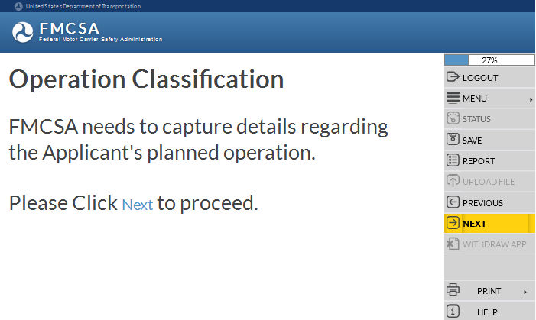
Operation Classification
Some of the questions in the following section may or may not display in the URS Online Application Process.
The questions display based on the answers selected or entered by the Applicant.
FMCSA needs to capture details regarding the Applicant’s planned operation:
Intermodal Equipment Provider
Transporting Property
Broker Services (Property, HHG)
Type of Cargo or Property Transporting
Transporting passengers
Freight Forwarder Services
Cargo Tank Facility
Driveaway or Towaway
Classification of Cargo
Notes:
Operation Classification.
Some of the questions in the following section may or may not display in the URS Online Application Process.
The questions display based on the answers selected or entered by the Applicant.
FMCSA needs to capture details regarding the Applicant’s planned operation.
This includes the following information:
Intermodal Equipment Provider
Transporting Property
Broker Services
Type of Cargo or Property Transporting
Transporting across state lines with/without HM
Transporting passengers
Receiving a grant from the FTA
Freight Forwarder Services
Cargo Tank Facility
Driveaway or Towaway
Classification of Cargo
Click Next in the Navigation Menu to move to the next page.

Slide 12
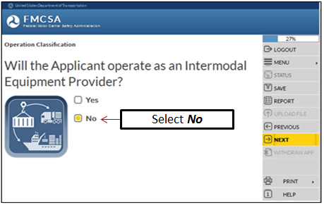
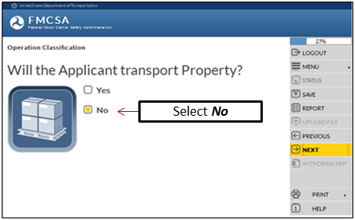
Operation Classification (Cont.)
Will the Applicant operate as an Intermodal Equipment Provider (IEP)?
Will the Applicant transport property?
Notes:
Will the Applicant operate as an Intermodal Equipment Provider (IEP)?
If the Applicant will NOT operate as an IEP select the No box.
Click Next in the Navigation Menu to move to the next page.
Will the Applicant transport Property?
If the Applicant will NOT transport property select the No box.
Click Next in the Navigation Menu to move to the next page.

Slide 13
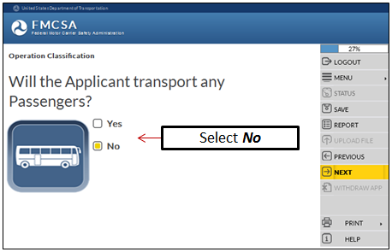
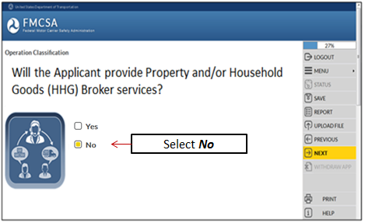
Operation Classification (Cont.)
Will the Applicant transport any Passengers?
Will the Applicant provide Property and/or Household Goods (HHG) Broker services?
Notes:
Will the Applicant transport any Passengers?
If the Applicant will NOT transport any Passengers, select the No box.
Click Next in the Navigation Menu to move to the next page.
Will the Applicant provide Property and/or Household Goods (HHG) Broker services?
If the Applicant will NOT provide Broker services, select the No box.
Click Next in the Navigation Menu to move to the next page.

Slide 14
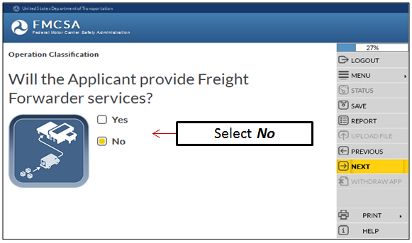
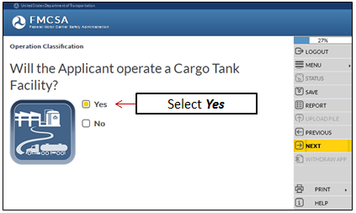
Operation Classification (Cont.)
Will the Applicant provide Freight Forwarder services?
Will the Applicant operate a Cargo Tank Facility?
Notes:
Will the Applicant provide Freight Forwarder services?
If the Applicant will NOT provide Freight Forwarder services, select the No box.
Click Next in the Navigation Menu to move to the next page.
Will the Applicant operate a Cargo Tank Facility?
If the Applicant will operate a Cargo Tank Facility, select the Yes box.
Click Next in the Navigation Menu to move to the next page.

Slide 15
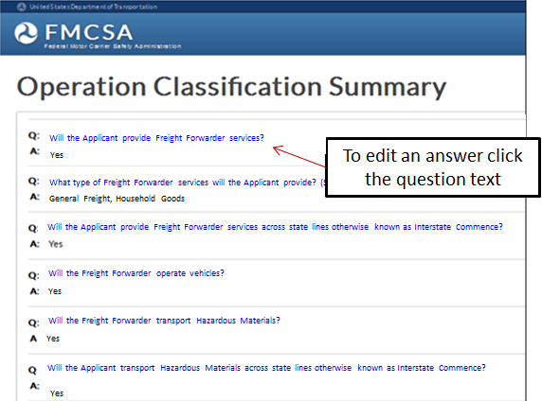
Operation Classification (Cont.)
Review the Operation Classification Summary to ensure the answers provided are correct
To change an answer, click the question text
No
Notes:
Review the Operation Classification Summary of questions and answers to ensure the information provided is correct.
To edit the answer to a question, click the question text to return to the question.
Click Next in the Navigation Menu to move to the next page.

Slide 16
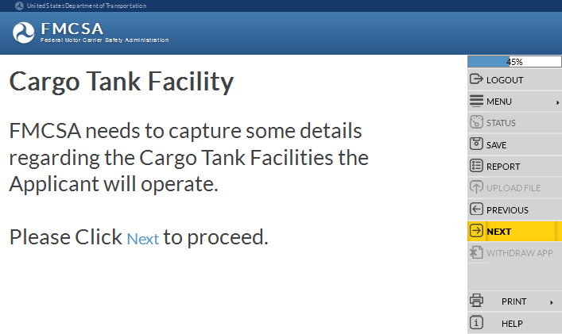
Cargo Tank Facility
The information requested in this section is needed for each Cargo Tank Facility being registered
FMCSA needs to capture some details regarding the Cargo Tank Facilities the Applicant will operate:
How many and the Names
Addresses
Functions, Exemptions, Special Permits, Vehicles
Manufacture or Repair functions
Uses mobile testing/inspection equipment
Contact, Inspector information
American Society of Mechanical Engineers (ASME) Certificate of Authorization
Certification
Notes:
Cargo Tank Facility.
The information being collected in this section is needed for each Cargo Tank Facility being registered.
FMCSA needs to capture some details regarding the Cargo Tank Facilities the Applicant will operate:
How many and the Names
Addresses
Functions, Exemptions, Special Permits, Vehicles
Manufacture or Repair functions
Uses mobile testing/inspection equipment
Contact, Inspector information
American Society of Mechanical Engineers (ASME) Certificate of Authorization
Certification
Click Next in the Navigation Menu to move to the next page.

Slide 17
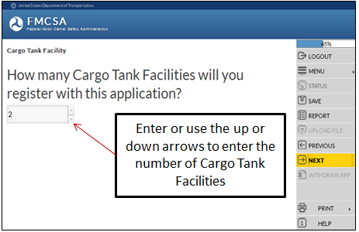
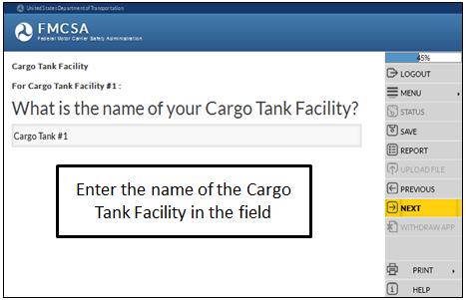
Cargo Tank Facility (Cont.)
How many Cargo Tank Facilities will you register with this application?
What is the name of your Cargo Tank Facility?
Notes:
How many Cargo Tank Facilities will you register with this application?
Enter or use the up or down arrows to enter the number of Cargo Tank Facilities being registered.
Click Next in the Navigation Menu to move to the next page.
What is the name of your Cargo Tank Facility?
Enter the name of your Cargo Tank Facility in the field.
Click Next in the Navigation Menu to move to the next page.

Slide 18
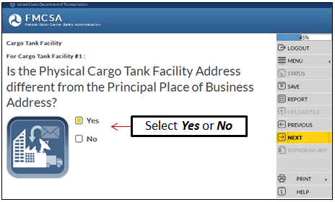
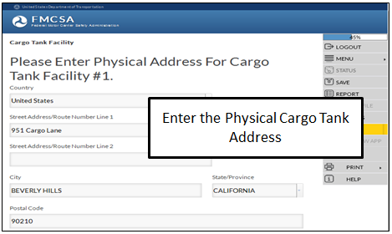
Cargo Tank Facility (Cont.)
Is the Physical Cargo Tank Facility Address different from the Principal Place of Business Address?
Provide the Physical Cargo Tank Facility Address if it is different from the Principal Place of Business Address.
P.O. Boxes are NOT accepted
Notes:
Is the Physical Cargo Tank Facility Address different from the Principal Place of Business Address?
If the Physical Cargo Tank Facility Address is different from the Principal Place of Business Address, select the Yes box.
If the Physical Cargo Tank Facility Address is NOT different from the Principal Place of Business Address, select the No box.
Click Next in the Navigation Menu to move to the next page.
Provide the Physical Cargo Tank Facility Address if it is different from the Principal Place of Business Address.
P.O. Boxes are NOT accepted.
Enter the address information in the fields.
Click Next in the Navigation Menu to move to the next page.

Slide 19
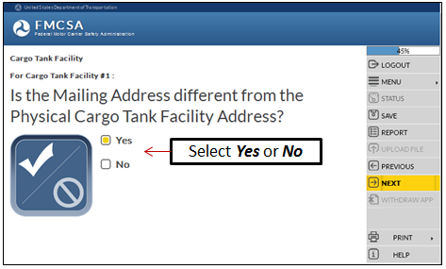
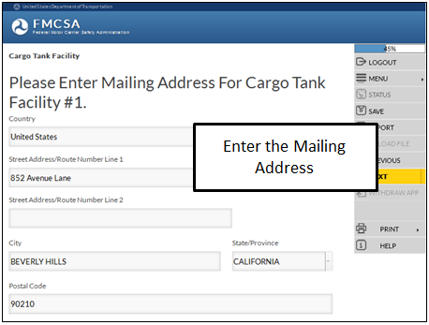
Cargo Tank Facility (Cont.)
Is the Mailing Address different from the Physical Cargo Tank Facility Address?
Provide the Mailing Address if it is different from the Physical Cargo Tank Facility Address.
Notes:
Is the Mailing Address different from the Physical Cargo Tank Facility Address?
If the Mailing Address is different from the Physical Cargo Tank Facility Address, select the Yes box.
Is the Mailing Address is NOT different from the Physical Cargo Tank Facility Address, select the No box.
Click Next in the Navigation Menu to move to the next page.
Provide the Mailing Address if it is different from the Physical Cargo Tank Facility Address.
Enter the address information in the fields.
Click Next in the Navigation Menu to move to the next page.

Slide 20
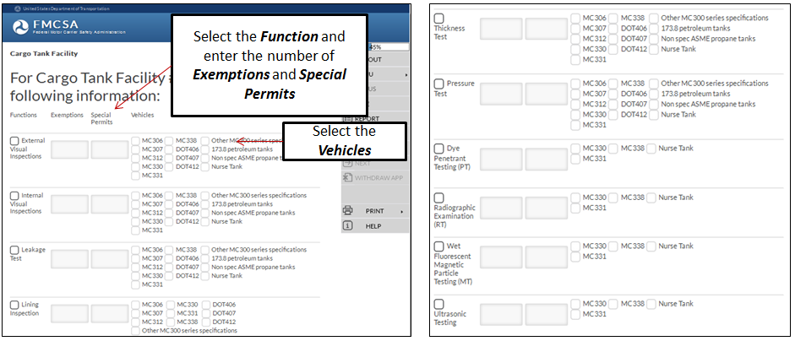
Cargo Tank Facility (Cont.)
For Cargo Tank Facility x, please provide the following information:
Functions, Exemptions, Special Permits and Vehicle
Notes:
For Cargo Tank Facility #x, provide the following information:
Functions. Select the Functions from the list.
Exemptions. Enter the Exemptions for the Cargo Tank Facility.
Special Permits. Enter the Special Permits for the Cargo Tank Facility.
Vehicle. Select the Vehicle information from the list.
Click Next in the Navigation Menu to move to the next page.

Slide 21
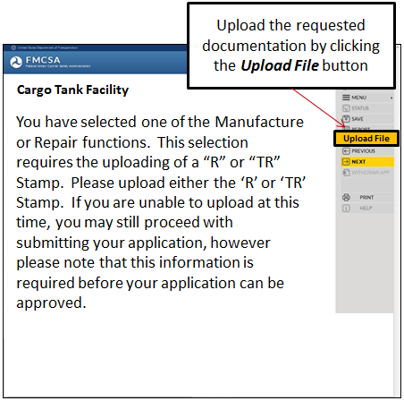
Cargo Tank Facility (Cont.)
You have selected one of the Manufacture or Repair functions:
This selection requires the uploading of a “R” or “TR” Stamp. Please upload either the ‘R’ or ‘TR’ Stamp
If you are unable to upload at this time, you may still proceed with submitting your application however please note this information is required before your application can be approved
Notes:
You have selected one of the Manufacture or Repair functions.
This selection requires the uploading of a “R” or “TR” Stamp.
Please upload either the ‘R’ or ‘TR’ Stamp.
If you are unable to upload at this time, you may still proceed with submitting your application, however please note that this information is required before your application can be approved.
For more detailed information on how to upload a document, reference the training module: “Introduction to Submit an Application for New Registration”.
Click Next in the Navigation Menu to move to the next page.

Slide 22
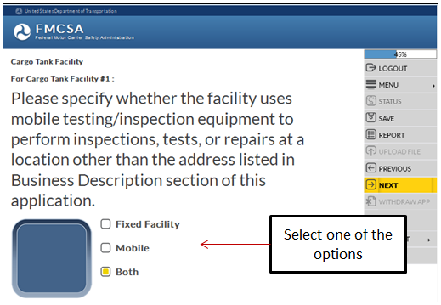
Cargo Tank Facility (Cont.)
Specify whether the facility uses mobile testing/inspection equipment to perform inspections, tests, or repairs at a location other than the address listed in Business Description section of this application.
Notes:
Specify whether the facility uses mobile testing/inspection equipment to perform inspections, tests, or repairs at a location other than the address listed in the Business Description section of this application.
Select the applicable option, Fixed Facility, Mobile or Both.
Click Next in the Navigation Menu to move to the next page.

Slide 23
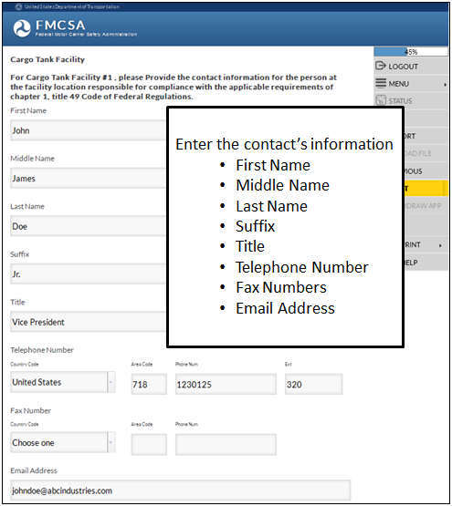
Cargo Tank Facility (Cont.)
Provide the contact information for the person at the facility location responsible for compliance with the applicable requirements of chapter 1, title 49 Code of Federal Regulations
Notes:
Provide the contact information for the person at the facility location responsible for compliance with the applicable requirements of chapter 1, title 49 Code of Federal Regulations.
Enter the persons information:
First Name
Middle Name
Last Name
Suffix, values include: Jr., Sr., 2nd , 3rd , II, III, IV, V, VI)
Title
Telephone Number
Fax Numbers
Email Address
Click Next in the Navigation Menu to move to the next page.

Slide 24
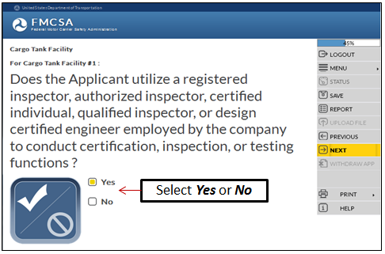
Cargo Tank Facility (Cont.)
Does the Applicant utilize a registered inspector, authorized inspector, certified individual, qualified inspector, or design certified engineer employed by the company to conduct certification, inspection, or testing functions?
Notes:
Does the Applicant utilize a registered inspector, authorized inspector, certified individual, qualified inspector, or design certified engineer employed by the company to conduct certification, inspection, or testing functions?
If the Applicant does utilize registered and authorized inspectors and engineers employed at the company to conduct functions, select the Yes box.
If the Applicant does NOT utilize registered and authorized inspectors and engineers employed at the company to conduct functions, select the No box.
Click Next in the Navigation Menu to move to the next page.

Slide 25
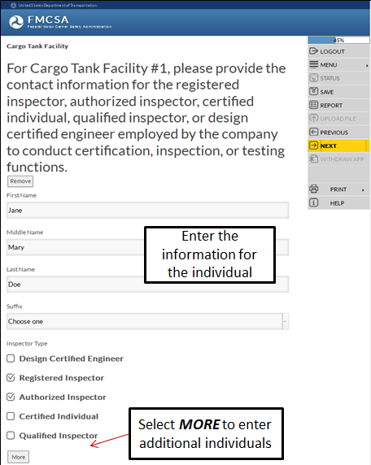
Cargo Tank Facility (Cont.)
Provide the contact information for the registered inspector, authorized inspector, certified individual, qualified inspector, or design certified engineer employed by the company to conduct certification, inspection, or testing functions
Notes:
Provide the contact information for the registered inspector, authorized inspector, certified individual, qualified inspector, or design certified engineer employed by the company to conduct certification, inspection, or testing functions:
First Name
Middle Name
Last Name
Suffix, values include the following: Jr., Sr., 2nd , 3rd , II, III, IV, V, VI
Inspector Type
Use the More button to enter additional persons.
Click Next in the Navigation Menu to move to the next page.

Slide 26
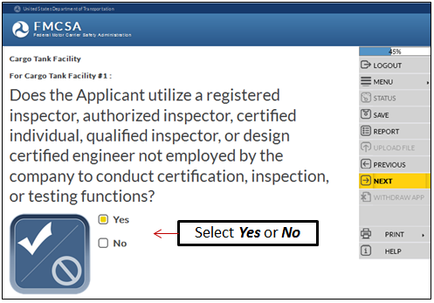
Cargo Tank Facility (Cont.)
Does the Applicant utilize a registered inspector, authorized inspector, certified individual, qualified inspector, or design certified engineer NOT employed by the company to conduct certification, inspection, or testing functions?
Notes:
Does the Applicant utilize a registered inspector, authorized inspector, certified individual, qualified inspector, or design certified engineer NOT employed by the company to conduct certification, inspection, or testing functions?
If the Applicant utilizes registered and authorized inspectors and engineers NOT employed at the company to conduct functions, select the Yes box.
If the Applicant does NOT utilize registered and authorized inspectors and engineers NOT employed at the company to conduct functions, select the No box.
Click Next in the Navigation Menu to move to the next page.

Slide 27
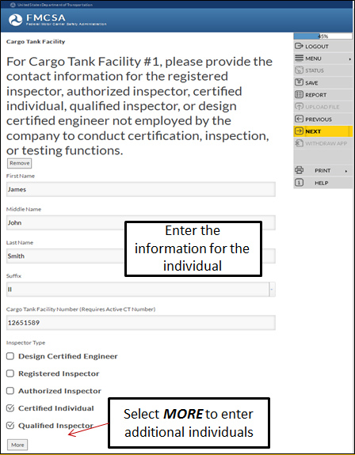
Cargo Tank Facility (Cont.)
Provide the contact information for the registered inspector, authorized inspector, certified individual, qualified inspector, or design certified engineer NOT employed by the company to conduct certification, inspection, or testing functions
Notes:
Provide the contact information for the registered inspector, authorized inspector, certified individual, qualified inspector, or design certified engineer NOT employed by the company to conduct certification, inspection, or testing functions:
First Name
Middle Name
Last Name
Suffix, values include the following: Jr., Sr., 2nd , 3rd , II, III, IV, V, VI
Inspector Type
Cargo Tank Facility Number (Provide an active Cargo Tank Number)
Use the More button to enter additional persons.
Click Next in the Navigation Menu to move to the next page.

Slide 28
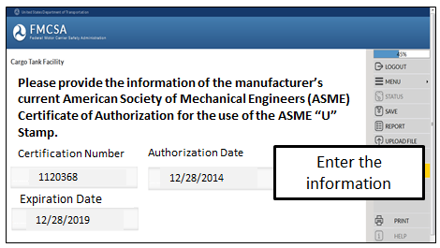
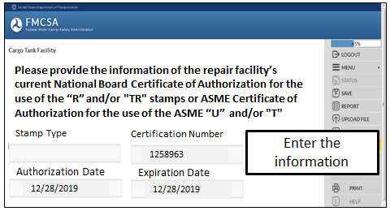
Cargo Tank Facility (Cont.)
Question displays only for a Manufacture
Question displays only for a Repair Facility
Provide the information of the manufacturer’s current American Society of Mechanical Engineers (ASME) Certificate of Authorization for the use of the ASME “U” Stamp
Provide the information of the repair facility’s current National Board Certificate of Authorization for the use of the “R” and/or "TR" stamps or ASME Certificate of Authorization for the use of the ASME “U” and/or "T" Stamps
Notes:
This question displays only for a Manufacture.
Please provide the information of the manufacturer’s current American Society of Mechanical Engineers (ASME) Certificate of Authorization for the use of the ASME “U” Stamp.
Certification Number
Authorization Date
Expiration Date
Click Next in the Navigation Menu to move to the next page.
This question displays only for a Repair Facility.
Provide the information of the repair facility’s current National Board Certificate of Authorization for the use of the “R” and/or "TR" stamps or ASME Certificate of Authorization for the use of the ASME “U” and/or "T" Stamps:
Stamp Type
Certification Number
Authorization Date
Expiration Date
Click Next in the Navigation Menu to move to the next page.

Slide 29
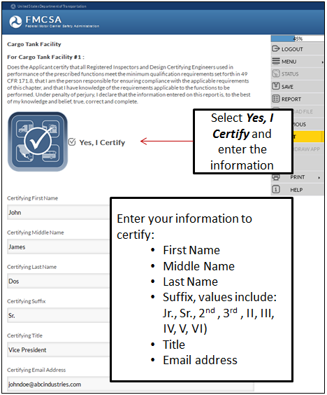
Cargo Tank Facility (Cont.)
Certify that all Registered Inspectors and Design Certifying Engineers used in performance of the prescribed functions meet the minimum qualification requirements set forth in 49 CFR 171.8
You are the person responsible for ensuring compliance with the applicable requirements of this chapter, and have knowledge of the requirements applicable to the functions to be performed
Notes:
Does the Applicant certify that all Registered Inspectors and Design Certifying Engineers used in performance of the prescribed functions meet the minimum qualification requirements set forth in 49 CFR 171.8, that I am the person responsible for ensuring compliance with the applicable requirements of this chapter, and that I have knowledge of the requirements applicable to the functions to be performed. Under penalty of perjury, I declare that the information entered on this report is, to the best of my knowledge and belief, true, correct and complete.
Select Yes, I Certify.
Enter your information:
First Name
Middle Name
Last Name
Suffix, values include: Jr., Sr., 2nd , 3rd , II, III, IV, V, VI)
Title
Email address
If the Applicant has more than one Cargo Tank Facility to register, the system will guide you to the next questions to enter the information for the additional Cargo Tank Facilities.
Click Next in the Navigation Menu to move to the next page.

Slide 30
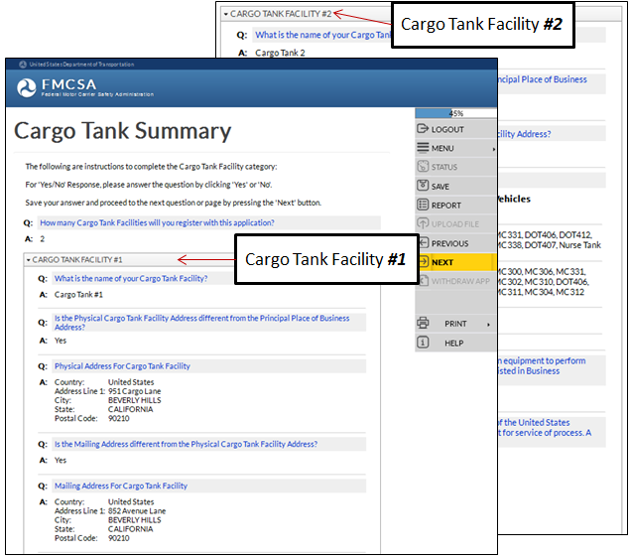
Cargo Tank Facility (Cont.)
Review the Cargo Tank Facility Summary to ensure the answers provided are correct
To change an answer, click the question text
Notes:
Review the Cargo Tank Facility Summary of questions and answers to ensure the information provided is correct.
To edit the answer to a question, click the question text to return to the question.
Click Next in the Navigation Menu to move to the next page.

Slide 31
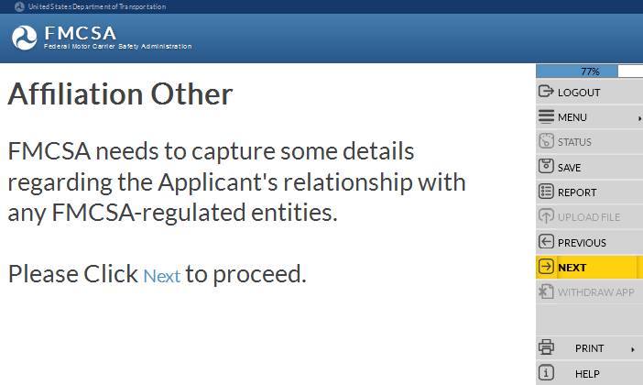
Affiliation with Others
For detailed information on this application section, reference the training module: “Introduction to Submit an Application for New Registration”
FMCSA needs to capture details regarding the Applicant’s relationship with any FMCSA-regulated entities:
If the Applicant has had, within the last 3 years of the date of filing this application, relationships involving common stock, ownership, management, control, familial relationships, or any other person(s) or applicant for registration provide the Entity’s USDOT Number
Notes:
Affiliation with Others.
FMCSA needs to capture some details regarding the Applicant's relationship with any FMCSA-regulated entities.
If the Applicant has had within the last 3 years of the date of filing this application relationships involving common stock, ownership, management, control or familial relationships or any other person(s) or applicant for registration provide the Entity’s USDOT Number.
For more detailed information about the Affiliation with Others section of the application, reference the training module: “Introduction to Submit an Application for New Registration”.
Enter the information and click Next in the Navigation Menu to move to the next page.

Slide 32
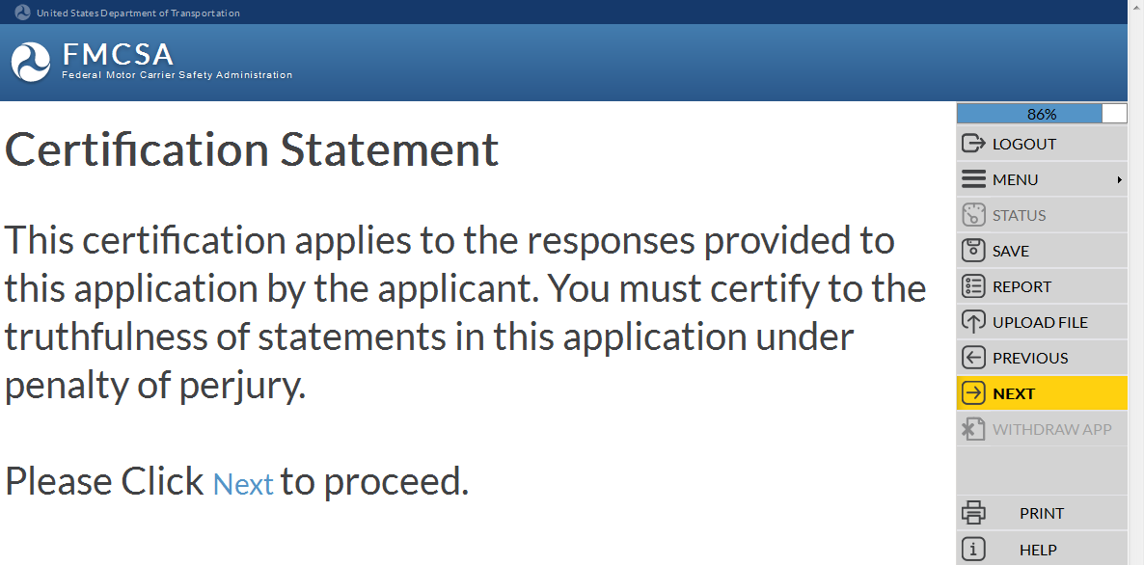
Certification Statement
This certification applies to the responses provided to this application by the Applicant
The Applicant must certify to the truthfulness of statements in this application under penalty of perjury
For detailed information on this application section, reference the training module: “Introduction to Submit an Application for New Registration”
Notes:
Certification Statement.
This certification applies to the responses provided to this application by the Applicant.
The Applicant must certify to the truthfulness of statements in this application under penalty of perjury.
For more detailed information about the Certification Statement section of the application, reference the training module: “Introduction to Submit an Application for New Registration”.
Enter the information and click Next in the Navigation Menu to move to the next page.

Slide 33
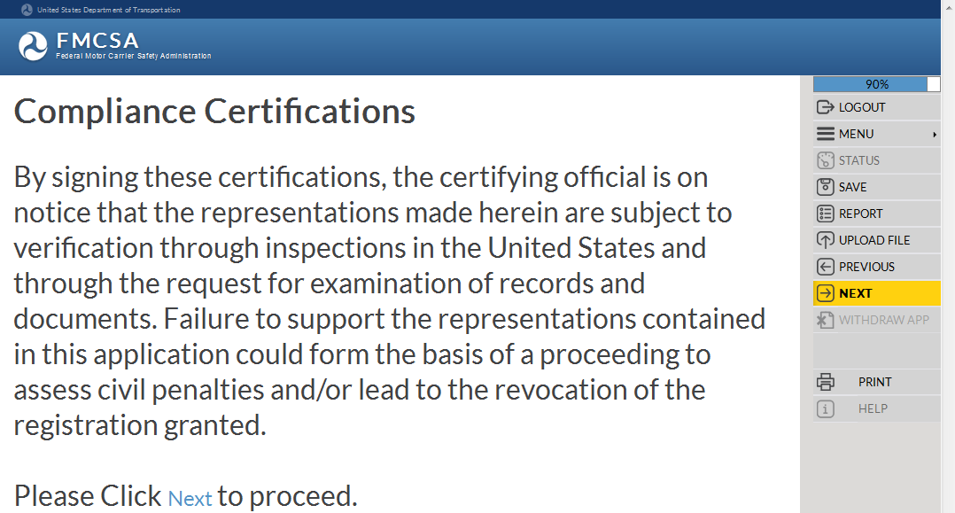
Compliance Certifications
Signing the certifications, the Certifying Official is on notice that the representations made are subject to verification through inspections in the U.S. and through the request for examination of records and documents
For detailed information on this application section, reference the training module: “Introduction to Submit an Application for New Registration”
Failure to support the representations in this application could form the basis of a proceeding to assess civil penalties and/or lead to the revocation of the registration granted
Notes:
Compliance Certifications.
By signing these certifications, the certifying official is on notice that the representations made herein are subject to verification through inspections in the United States and through the request for examination of records and documents.
Failure to support the representations contained in this application could form the basis of a proceeding to assess civil penalties and/or lead to the revocation of the registration granted.
For more detailed information about the Compliance Certifications section of the application, reference the training module: “Introduction to Submit an Application for New Registration”.
Enter the information and click Next in the Navigation Menu to move to the next page.

Slide 34
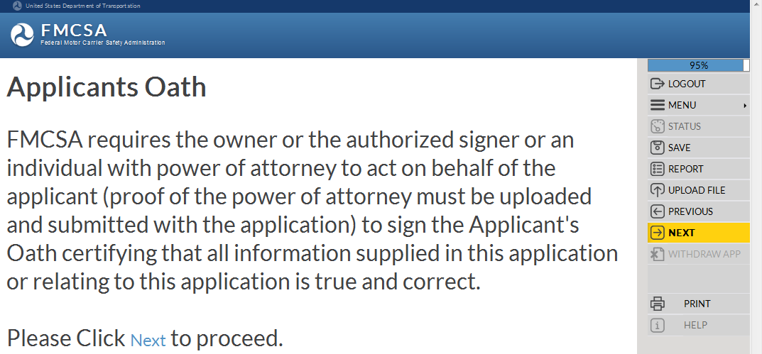
Applicant’s Oath
FMCSA requires the Owner or the Authorized Signer or an individual with power of attorney to act on behalf of the Applicant to sign the Applicant’s Oath certifying all information supplied in this application or relating to this application is true and correct
For detailed information on this application section, reference the training module: “Introduction to Submit an Application for New Registration”
Notes:
Applicant’s Oath.
FMCSA requires the owner or the authorized signer or an individual with power of attorney to act on behalf of the applicant (proof of the power of attorney must be uploaded and submitted with the application) to sign the Applicant's Oath certifying that all information supplied in this application or relating to this application is true and correct.
For more detailed information about the Applicant’s Oath section of the application, reference the training module: “Introduction to Submit an Application for New Registration”.
Enter the information and click Next in the Navigation Menu to move to the next page.

Slide 35
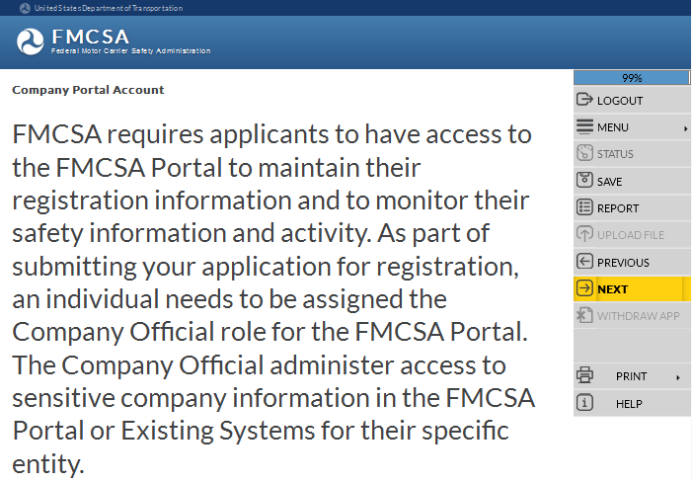
URS Company Official Portal Account
Applicants are required to have FMCSA Portal access to maintain their registration information and to monitor their safety information and activity
An individual needs to be assigned the Company Official role for the FMCSA Portal
For detailed information on this application section, reference the training module: “URS Company Official Portal Account”
Notes:
URS Company Official Portal Account.
FMCSA requires applicants to have access to the FMCSA Portal to maintain their registration information and to monitor their safety information and activity.
As part of submitting the application for registration, an individual needs to be assigned the Company Official role for the FMCSA Portal.
The Company Official administers access to sensitive company information in the FMCSA Portal or Existing Systems for their specific entity.
For more detailed information about the FMCSA Portal Company Official Account section of the application, reference the training module: “URS Company Official Portal Account”.
Click Next in the Navigation Menu to move to the next page.

Slide 36
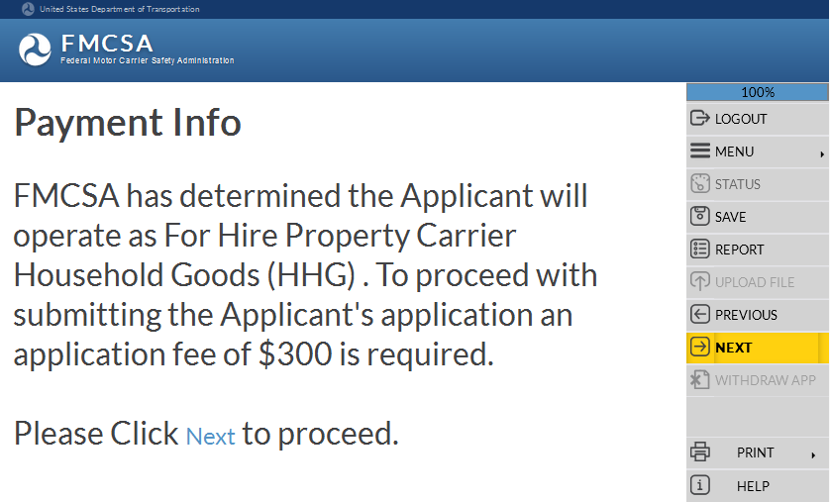
Payment Information
Operation Classification(s) determines the Applicant's required application fee dollar amount
FMCSA does NOT refund filing fees
Filing fees must be payable to the FMCSA, by a U.S. EFT or a credit card
For detailed information on this application section, reference the training module: “Introduction to Submit an Application for New Registration”
Applications aren’t processed until the payment has been deducted from a bank or credit card account
Notes:
Payment Information.
Based on the Operation Classification(s), FMCSA determines the Applicant's required application fee dollar amount.
FMCSA does not refund filing fees
Your filing fees must be payable to the FMCSA, by Electronic Funding Transfer (EFT), or by an approved credit card
EFT must be from an account in a bank in the United States
Fees are required for each type of registration requested. For example, if applicant wishes to be registered as both a motor carrier and a broker, applicant may file a single application and make a single payment of $600.
FTA grantees do not pay a fee to file an application for registration
FMCSA will not process an applicant’s application until the payment has been deducted from his/her banking or credit card account
Creation of a FMCSA application does not guarantee access to the FMCSA Portal Account
For more detailed information about the Payment Information section of the application, reference the training module: “Introduction to Submit an Application for New Registration”.
Click Next in the Navigation Menu to move to the next page.

Slide 37
End of the Training Module
End of the Training Module
Please Close the Browser Window
Notes:
This is the end of the training module, please close the browser window.

